Slide 1
Basic Electronic
Operational – Amplifier

Slide 2
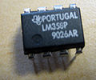

Operational Amplifier
An Operational Amplifier (Op-Amp) is an integrated circuit that uses external voltage to amplify the input through a very high gain.

Slide 3
Operational Amplifier
The actual count varies, but an Op-Amp contains several Transistors, Resistors, and a few Capacitors and Diodes.
For simplicity, an Op-Amp is often depicted as this:
Positive Power Supply
Inverting Input
-
Output
Non-Inverting Input
+
Negative Power Supply

Slide 4
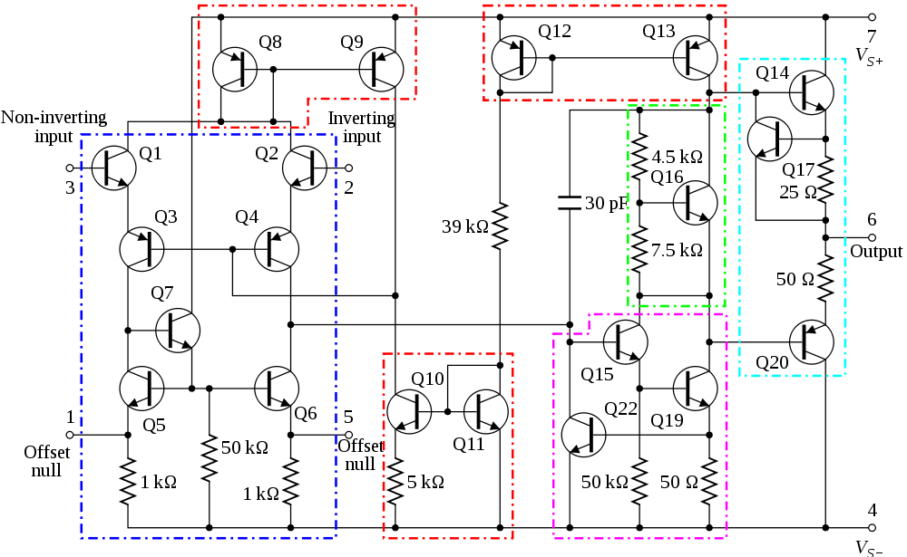
741 Op-Amp Schematic

Slide 5
Voltage Gain
The gain of the Op-Amp itself is calculated as:
G = V_{out}/(V₊ – V₋)
The maximum output is the power supply voltage
When used in a circuit, the gain of the circuit (as opposed to the op-amp component) is:
A_{v} = V_{out}/V_{in}

Slide 6
Op-Amp Saturation
The maximum output value is the supply voltage, positive and negative.
The gain (G) is the slope between saturation points.
V_{out}
V_{s}⁺
V_{in}
V_{s}⁻

Slide 7
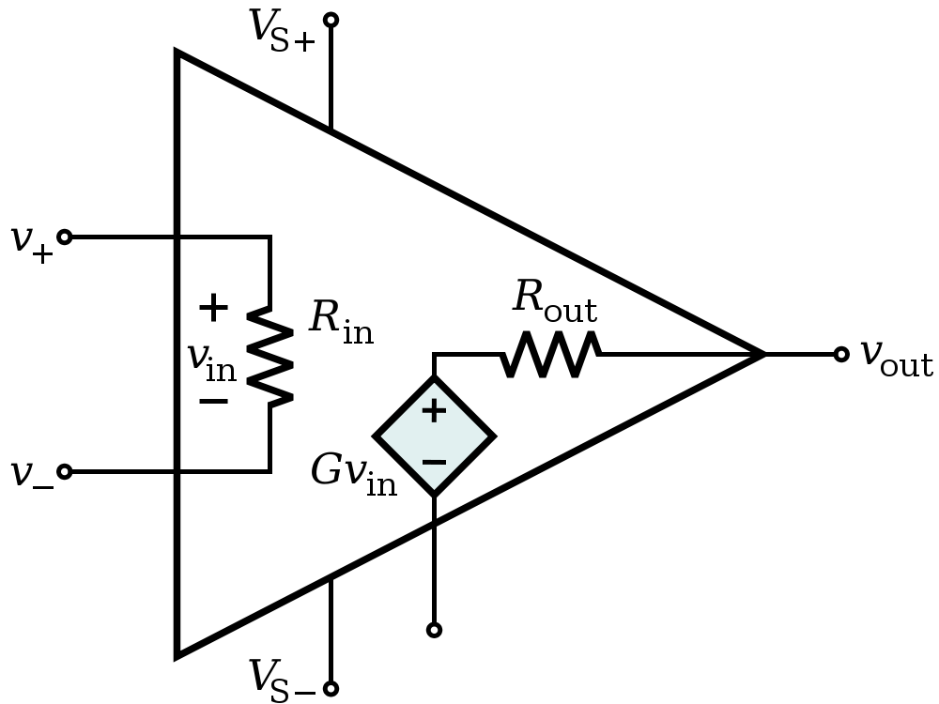
Ideal Op-Amp Characteristics
Open-loop gain G is infinite
R_{in} is infinite
Zero input current
R_{out} is zero

Slide 8
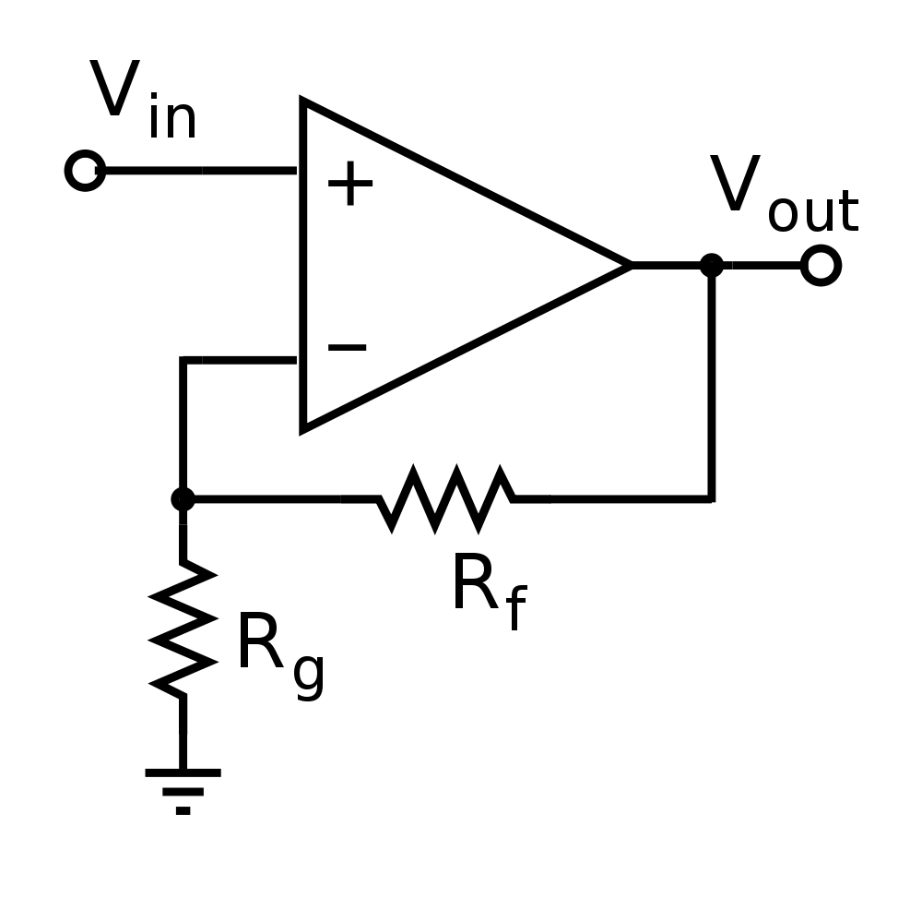
Ideal Op-Amp Analysis
To analyze an op-amp feedback circuit:
  Assume no current flows into either input terminal
  Assume no current flows out of the output terminal
  Constrain: V₊ = V₋

Slide 9
Inverting Amplifier
Kirchhoff node equation at V₊ yields,
Kirchhoff node equation at V₋ yields,
Setting V₊ = V– yields
Notice: The closed-loop gain V_{o}/V_{in} is dependent upon the ratio of two resistors, and is independent of the open-loop gain. This is caused by the use of feedback output voltage to subtract from the input voltage.

Slide 10
Noninverting Amplifier
Kirchhoff node equation at V₊ yields,
Kirchhoff node equation at V₋ yields,
Setting V₊ = V– yields
or

Slide 11
Summing Amplifier
Kirchhoff node equation at V₊ yields,
Kirchhoff node equation at V₋ yields,
Setting V₊ = V– yields

Slide 12
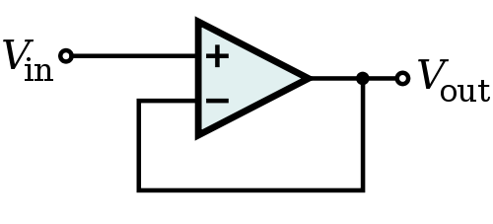
Op-Amp Buffer
Vout = Vin
Isolates loading effects
A
High output impedance
B
Low input impedance

Slide 13
Op-Amp Differentiator

Slide 14
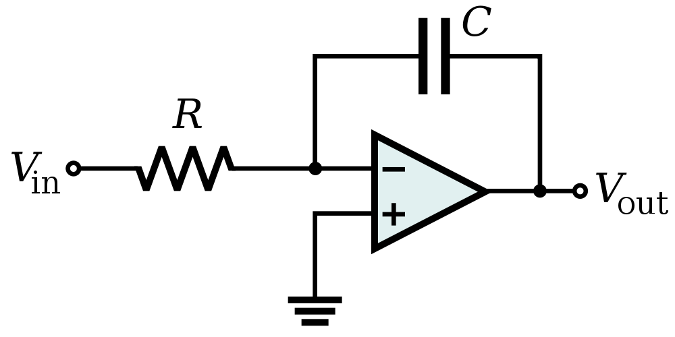

Op Amp Integrator

Slide 15
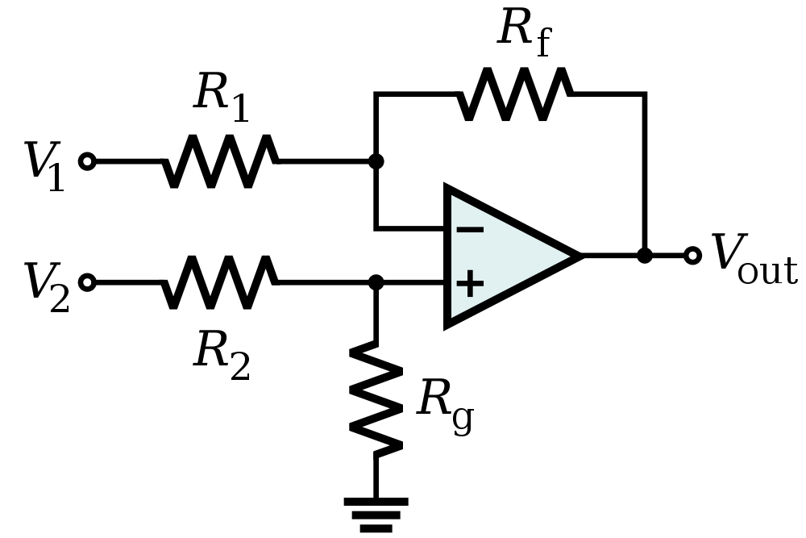


Op-Amp Differential Amplifier
If R₁ = R₂ and R_{f} = R_{g}:

Slide 16
Common-Mode Rejection Ratio (CMRR)
Differential voltage input :
Common voltage input :
Common-mode rejection ratio:
Output voltage :
Note:
When G_{d} >> G_{c} or CMRR →∞
⇒V_{o} = G_{d}V_{d}
G_{d} : Differential gain
G_{c} : Common mode gain

Slide 17
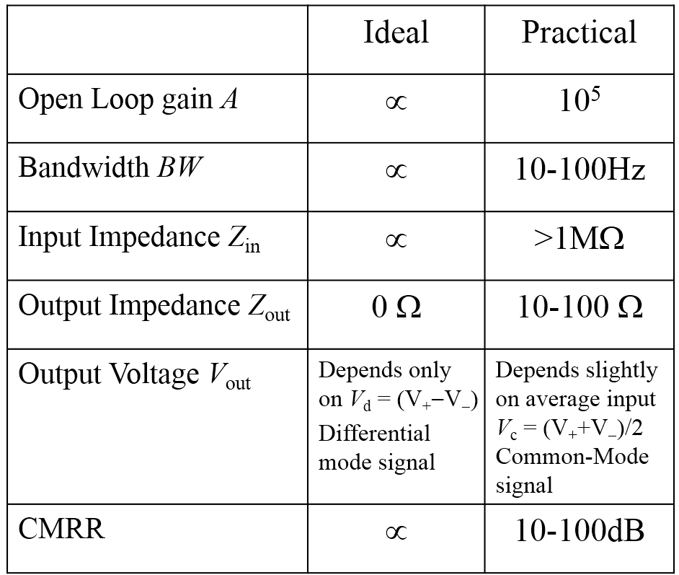
Ideal and Practical Op-Amp

