Slide 1
Some uses of Atomic Physics
Exam Structure of Both papers

Slide 2
Exam Structure-PHY 1091
PHY1091
FA1, FA2, FA3 | 20%
Pretest | 2%
Posttest Pretest<Posttest & Both tests done 5% | 15%
Final Exam | 60%
Total | 100%
One hour exam:
20 MCQ questions-five short problems
One Essay Question:
Hint: Watch two videos under Lecture materials
- How does the scattering of laser light by atoms or molecules help scientists infer structural or environmental information?

Slide 3
Exam Structure-PHY 2081(Atomic & Nuclear Physics)
PHY 2081
FA1, FA2, FA3, FA4,(BEST 3) + In-class GROUP | 20%
Pretest | 2%
Posttest Pretest<Posttest & Both tests done 5% | 15%
Final Exam | 60%
Total | 100%
One hour exam:
20 MCQ questions-five short problems
One essay question:
Hint: Fusion vs Fission
Discuss the potential of nuclear fusion compared to nuclear fission as a future energy solution. In your answer, consider factors such as sustainability, safety, technological challenges, and economic feasibility.

Slide 4
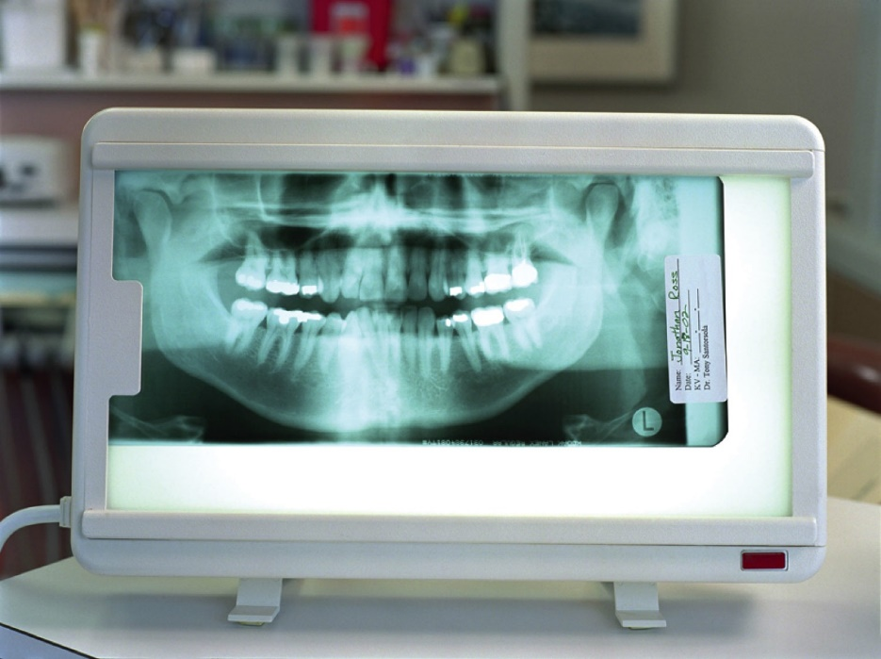
X-Rays from Atoms
The highest photon energy available in a hydrogen atom is in the ultraviolet part of the electromagnetic spectrum
Other atoms can emit much more energetic photons
May applications use X-ray photons obtained from an electron transition from E₂ to E₁ in heavier atoms
  These are called K_{α} X-rays
Section 29.3

Slide 5
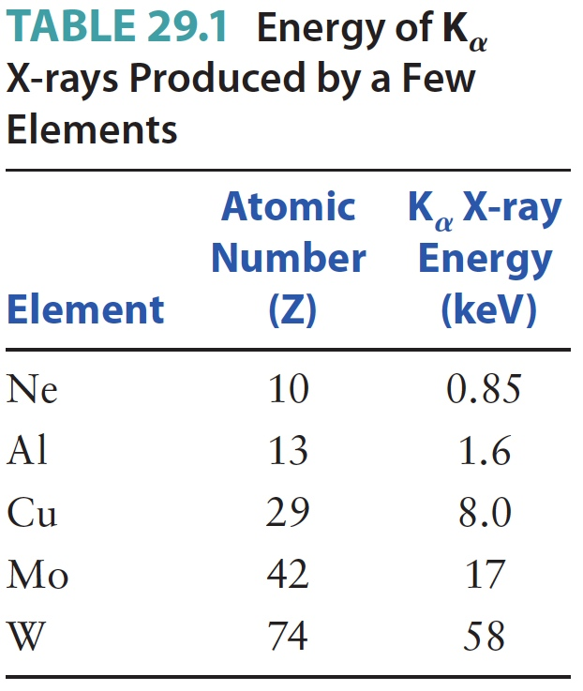
  Energy of K_{α} X-rays produced by some elements

Slide 6
Lasers
Lasers depend on the coherent emission of light by many atoms, all at the same frequency
In spontaneous emission, each atom emits photons independently of the other atoms
  It is impossible to predict when it will emit a photon
  The photons are radiated randomly in all directions
In a laser, an atom undergoes a transition and emits a photon in the presence of many other photons that have energies equal to the atom’s transition energy
A process known as stimulated emission causes the light emitted by this atom to propagate in the same direction and with the same phase as surrounding light waves
Section 29.7

Slide 7
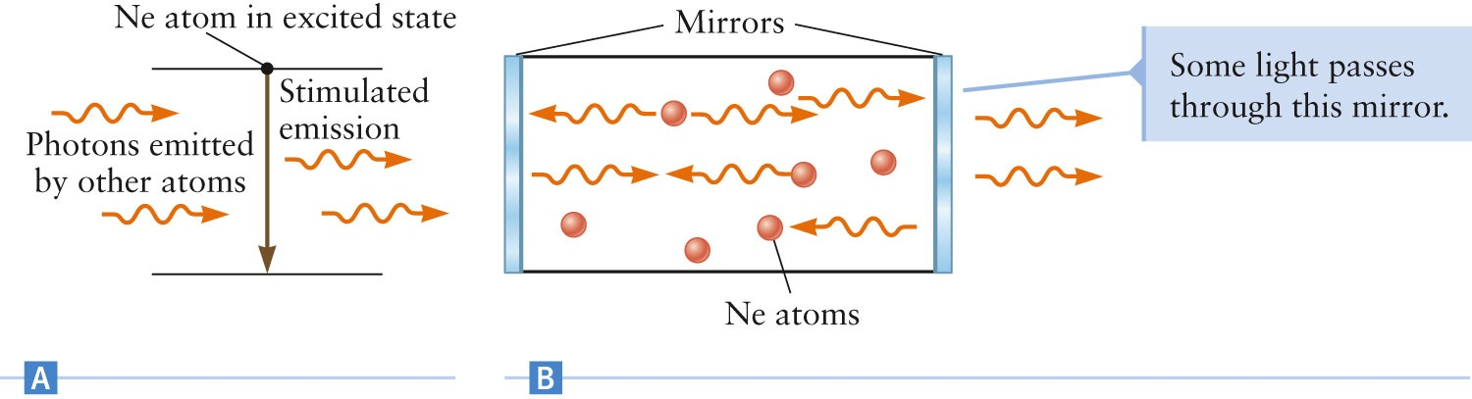
Lasers, cont.
Laser is an acronym for
“light amplification by stimulated emission of radiation”
The light from a laser is thus a coherent source
Mirrors are located at the ends of the bulb (laser tube)
One of the mirrors lets a small amount of the light pass through and leave the laser
Section 29.7

Slide 8
Lasers, final
Laser can be made with a variety of different atoms
One design uses a mixture of Ne and He gas and is called a helium-neon laser
  The photons emitted by the He-Ne laser have a wavelength of about 633 nm
Another common type of laser is based on light produced by light-emitting diodes (LEDs)
  These photons have a wavelength around 650 nm
  These are used in optical barcode scanners
Section 29.7

Slide 9
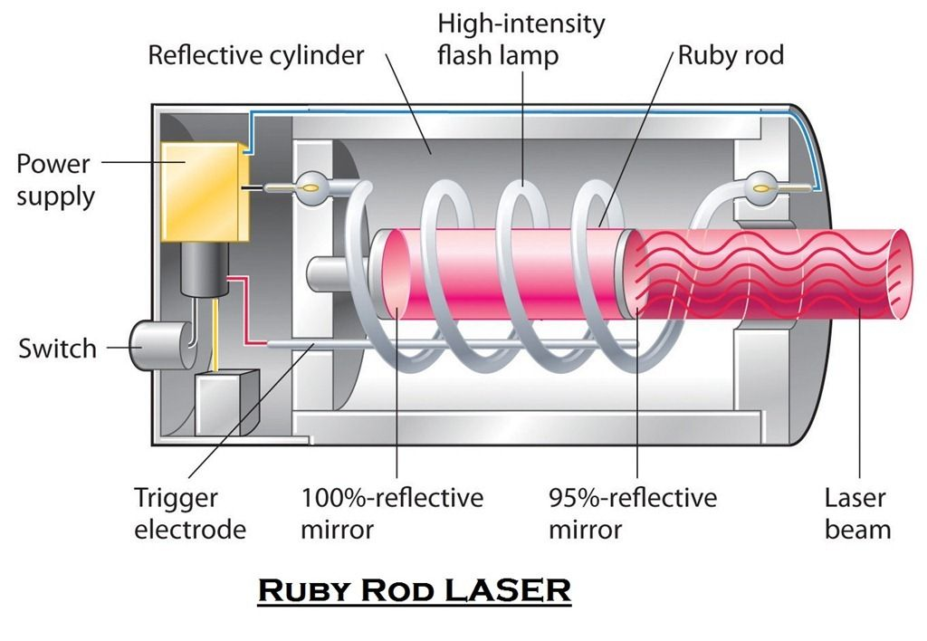
Laser – Practice problem
A ruby laser delivers a 2.28 J pulse in approximately 50 nanoseconds. The wavelength of the light is 694.4 nm. At least how many atoms within the ruby rod had to be excited to allow this high-energy laser pulse?
(h = 6.626 × 10⁻³⁴ Js,
c = 3.00×10⁸ m/s,
1 eV = 1.6 × 10⁻¹⁹ J, and
1 nm = 10⁻⁹ m)

Slide 10
LASIK– Practice problem
Consider a laser eye surgery, in which laser light with a wavelength of 514 nm at a power output of 1.5 W is used to reattach a detached retina. Suppose the laser is pulsed for 0.05 s time intervals.
During this time, how many photons are emitted by the laser?
What is the difference in energy between the two energy levels involved in this laser transition?

