Slide 1
Day 04
Quantum Mechanical Approach
Chemical Properties + Periodic Table
Energy Configurations

Slide 2
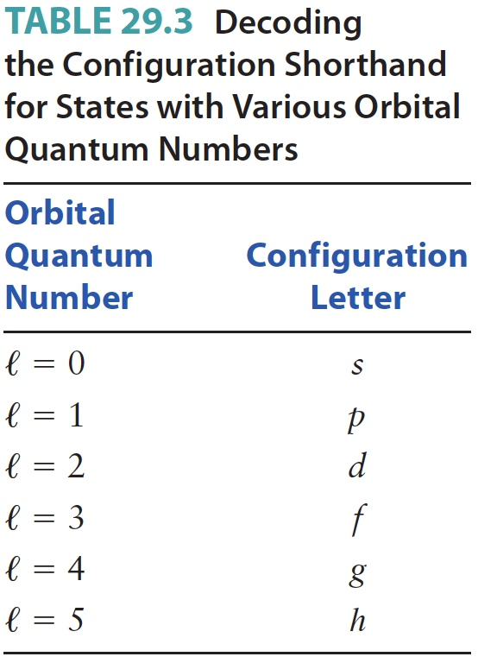
Orbital Quantum Number
ℓ is the orbital quantum number
  Allowed values are ℓ = 0, 1, 2, … n - 1
  The angular momentum of the electron is proportional to ℓ
    States with ℓ = 0 have no angular momentum
  See the table for shorthand letters for various ℓ values
Section 29.4

Slide 3
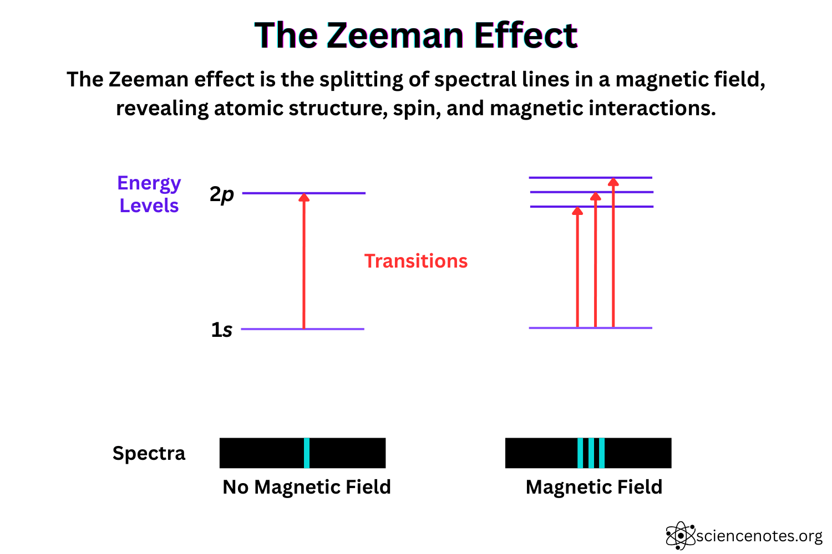
The Zeeman Effect
Zeeman Effect Apparatus

Slide 4
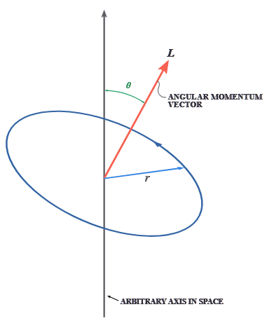
Orbital Magnetic Quantum Number
m_{l} is the orbital magnetic quantum number
  It has allowed values of m_{l} = - ℓ, -ℓ + 1, … , -1, 0, 1 … , ℓ
  You can think of m_{l} as giving the direction of the angular momentum of the electron in a particular state

Slide 5
Spin Quantum Number
m_{s} is the spin quantum number
  m_{s} = + ½ or – ½
    These are often referred to as “spin up” and “spin down”
  This gives the direction of the electron’s spin angular momentum
Section 29.4

Slide 6
Electron Shells and Probabilities
A particular quantized electron state is specified by all four of the quantum number n, ℓ, m_{l} and m_{s}
The solution of Schrödinger’s equation also gives the wave function of each quantum state
  From the wave function, you can calculate the probability for finding the electron at different locations around the nucleus
Plots of probability distributions for an electron are often called “electron clouds”
Section 29.4

Slide 7
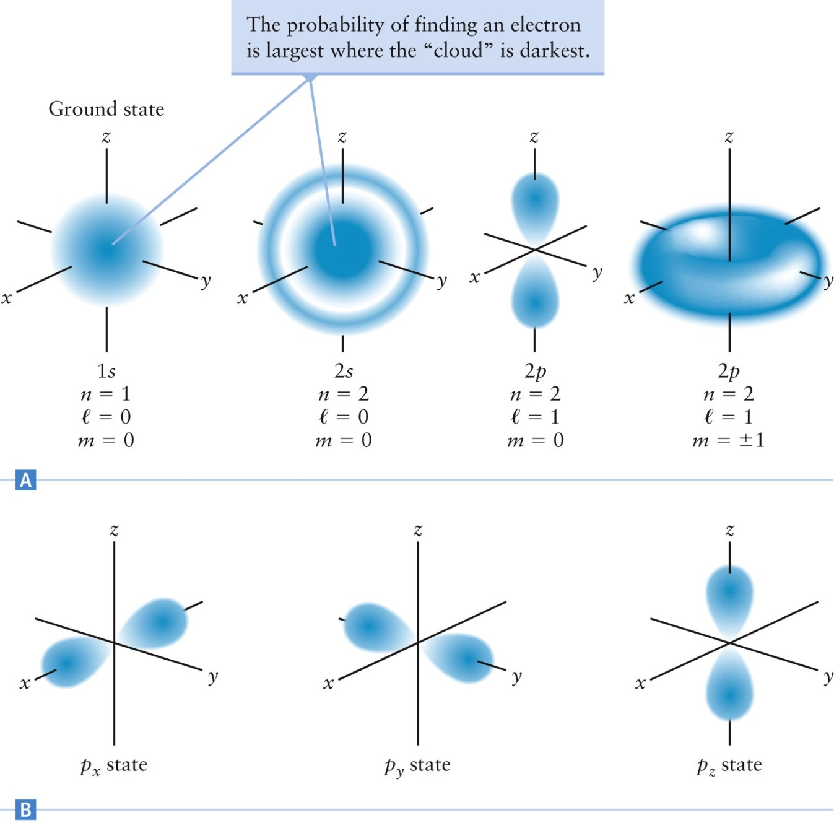

Slide 8
Multielectron Atoms
The electron energy levels of multielectron atoms follow the same pattern as hydrogen
  Use the same quantum numbers
The electron distributions are also similar
There are two main differences between hydrogen and multielectron atoms
  The values of the electron energies are different for different atoms
  The spatial extent of the electron probability clouds varies from element to element
Section 29.5

Slide 9
Pauli Exclusion Principle
Each quantum state can be occupied by only one electron
  Each electron must occupy its own quantum state, different from the states of all other electrons
This is called the Pauli exclusion principle
Each electron is described by a unique set of quantum numbers
Section 29.5

Slide 10
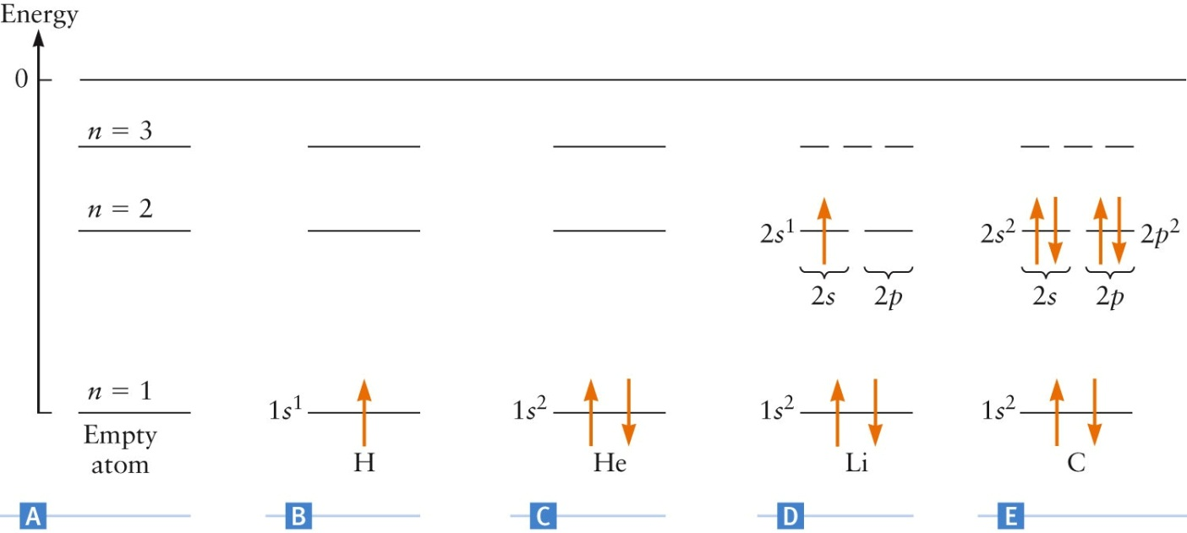
Electron Distribution
The direction of the arrow represents the electron’s spin
In C, the He electrons have different spins and obey the Pauli exclusion principle

Slide 11
Electron Configuration
There is a useful shorthand notation for showing electron configurations
Examples:
  H atom: 1s¹
    1 → n =1
    s → ℓ = 0
    Superscript 1 → 1 electron
    No information about electron spin
  C atom: 1s²2s²2p²
    2 electrons in n = 1 with ℓ = 0
    2 electrons in n = 2 with ℓ = 0
    2 electrons in n = 2 with ℓ = 1
Section 29.5

Slide 12
Filling Energy Levels
The energy of each level depends mainly on the value of n
In multielectron atoms, the order of energy levels is more complicated
For shells higher than n = 2, the energies of subshells from different shells being to overlap
In general, the energy levels fill with electrons in the following order:
1s 2s 2p 3s 3p 4s 3d 4p 5s 4d 5p 6s 4f
Section 29.5

Slide 13
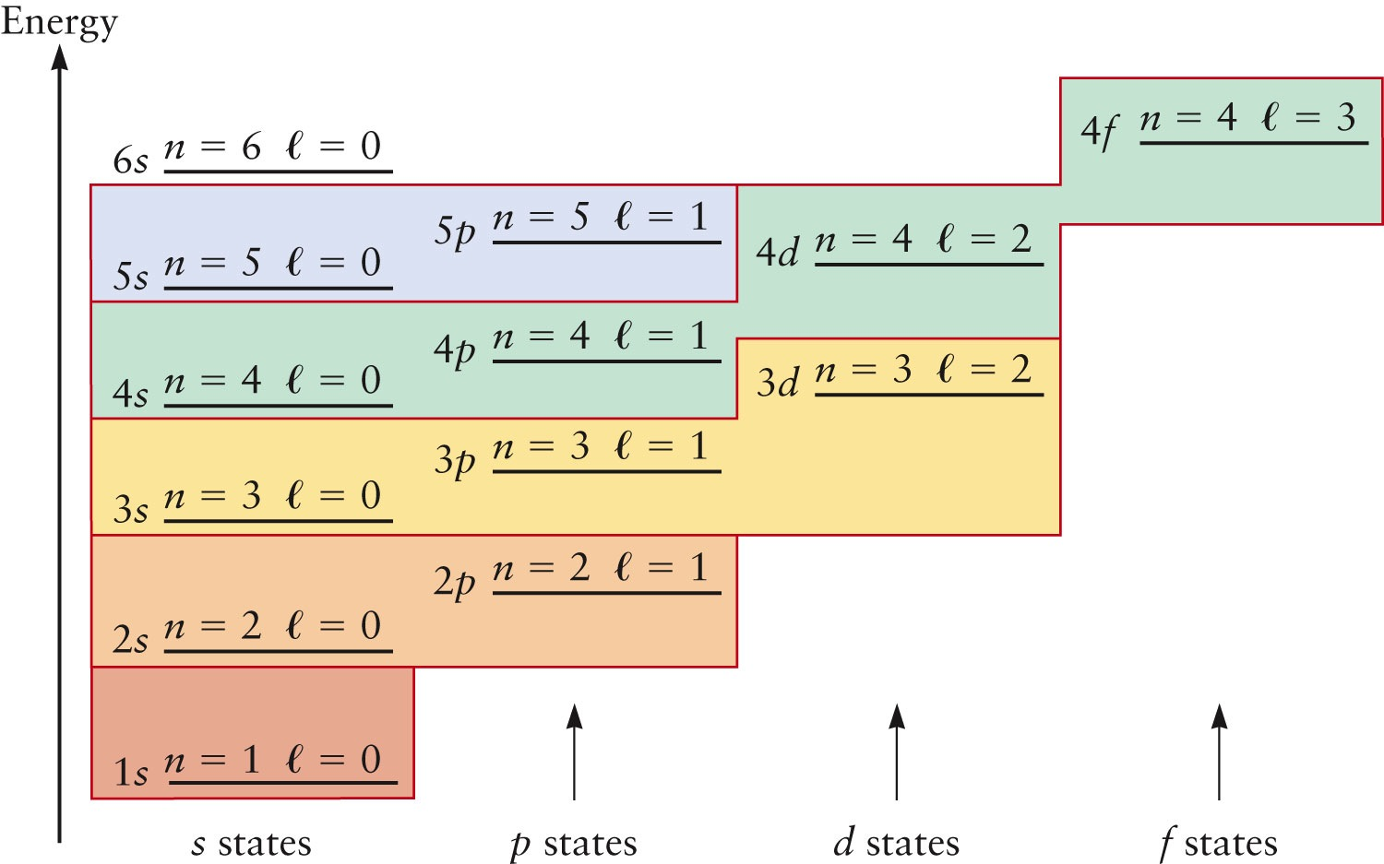
Order of Energy Levels

Slide 14
Selection Rules
Selection rules are guidelines that determine the allowed and forbidden transitions between quantum states, playing a
crucial role in spectroscopy and quantum mechanics.
Δn = anything
Δl = ± 1
Δm_{l} = 0 or ± 1
Δm_{s} = 0

Slide 15
PBL 1
Which of the following transitions are allowed in Hydrogen? In each case the notation represents the quantum numbers (n, l, m_{l},m_{s})
(2, 1, 0, 1/2) to (1, 0, 0, -1/2)
(5, 2, 1, 1/2) to (3, 2, 0, -1/2)
(6, 2, -1, -1/2) to (2, 1, 0, -1/2)
(2, 0, 0, 1/2) to (3, 1, -1, -1/2)

Slide 16
Chemical Properties of Elements
Quantum theory explains the structure of the periodic table
The periodic table was first assembled by Dmitry Mendeleyev in the late 1860’s
Mendeleyev and other chemists had noticed that many elements could be grouped according to their chemical properties
Mendeleyev organized his table by grouping related elements in the same column
His table had a number of “holes” because many elements had not yet been discovered
Section 29.6

Slide 17
Chemical Properties, cont.
Mendeleyev could not explain why the regularities in the periodic table occurred
The electron energy levels and the electron configuration of the atom are responsible for its chemical properties
When an atom participates in a chemical reaction, some of its electrons combine with electrons from other atoms to form chemical bonds
The bonding electrons are those occupying the highest energy levels
Section 29.6

Slide 18
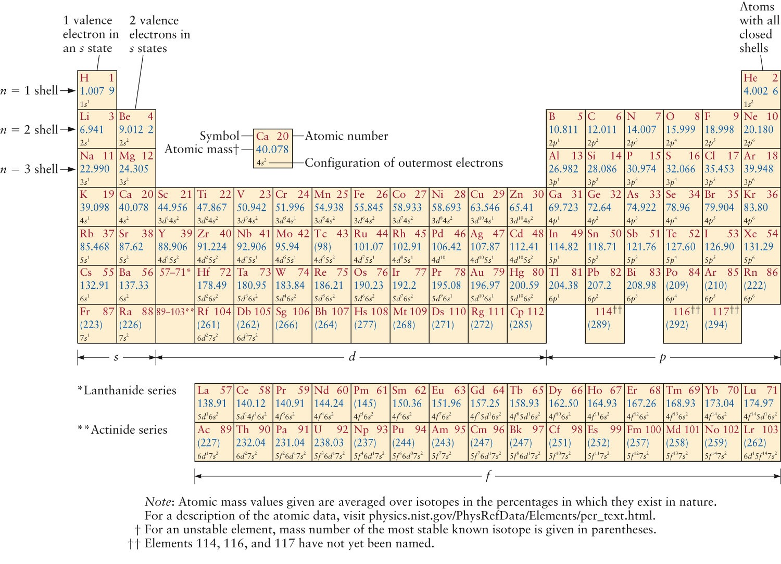
Periodic Table
Section 29.6

Slide 19
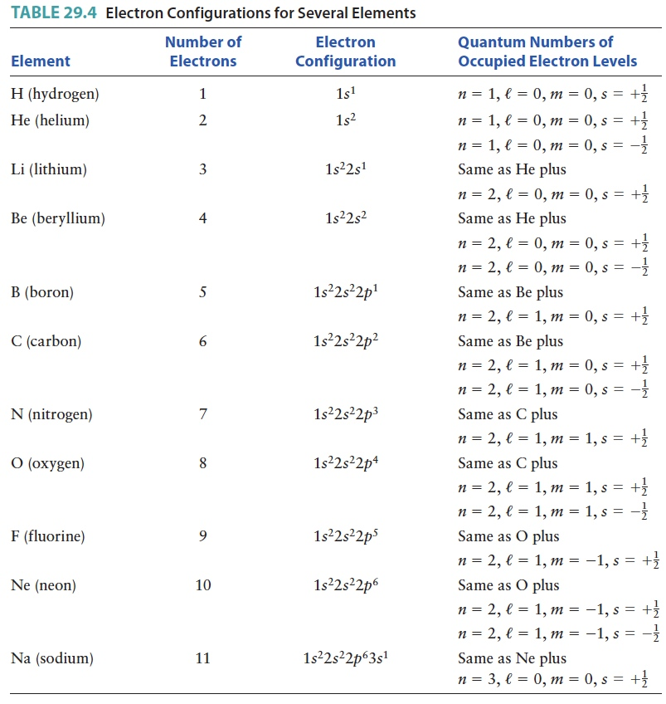
Electron Configurations

Slide 20
Electrons and Shells
The electron that forms bonds with other atoms is a valence electron
When a shell has all possible states filled it forms a closed shell
Elements in the same column in the periodic table have the same number of valence electrons
The last column in the periodic table contains elements with completely filled shells
  These elements are largely inert
  They almost never participate in chemical reactions
Section 29.6

Slide 21
Structure of the Periodic Table
Mendeleyev grouped elements into columns according to their common bonding properties and chemical reactions
  These properties rely on the valence electrons and can be traced to the electron configurations
The rows correspond to different values of the principle quantum number, n
  Since the n = 1 shell can hold only two electrons, the row contains only two elements
  The number of elements in each row can be found by using the rules for allowed quantum numbers
Section 29.6

Slide 22
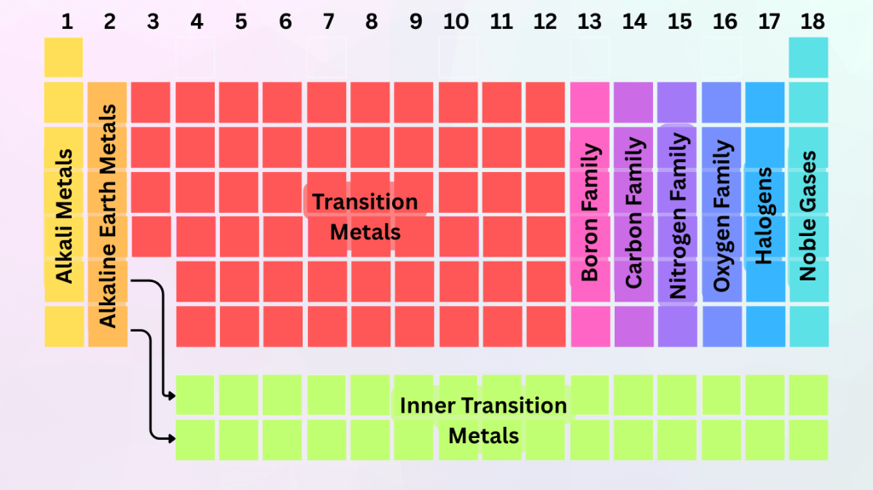

Slide 23
Problem Based Learning 2:
A Silicon atom contains 14 electrons. Determine its electron configuration
and construct the corresponding diagram of occupied levels.
2. What is the electron configurations of the ion O⁻² ?

