Slide 1


Slide 2
Day 03
Bohr’s Model of the Atom
Hydrogen Atom + Quantum Numbers
Multi-electron Atoms

Slide 3
Ideas In Bohr’s Model
Circular electron orbits
  For simplification
Used hydrogen
  Simplest atom
Postulated only certain electron orbits are allowed
  To explain discrete spectral lines
  Only specific values of r are allowed
  Then only specific energies are allowed based on the values of r
Energy level diagrams can be used to show absorption and emission of photons
Explained the experimental evidence
Section 29.3

Slide 4
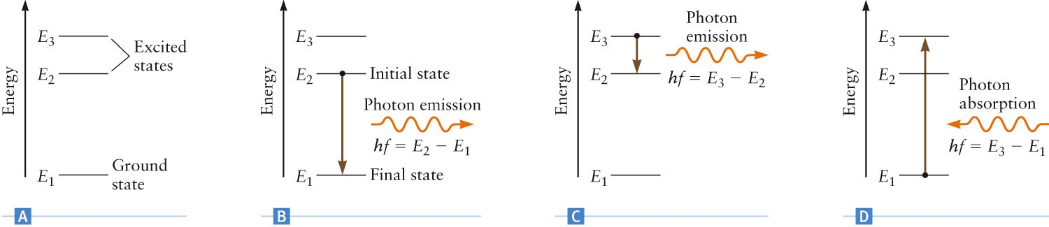
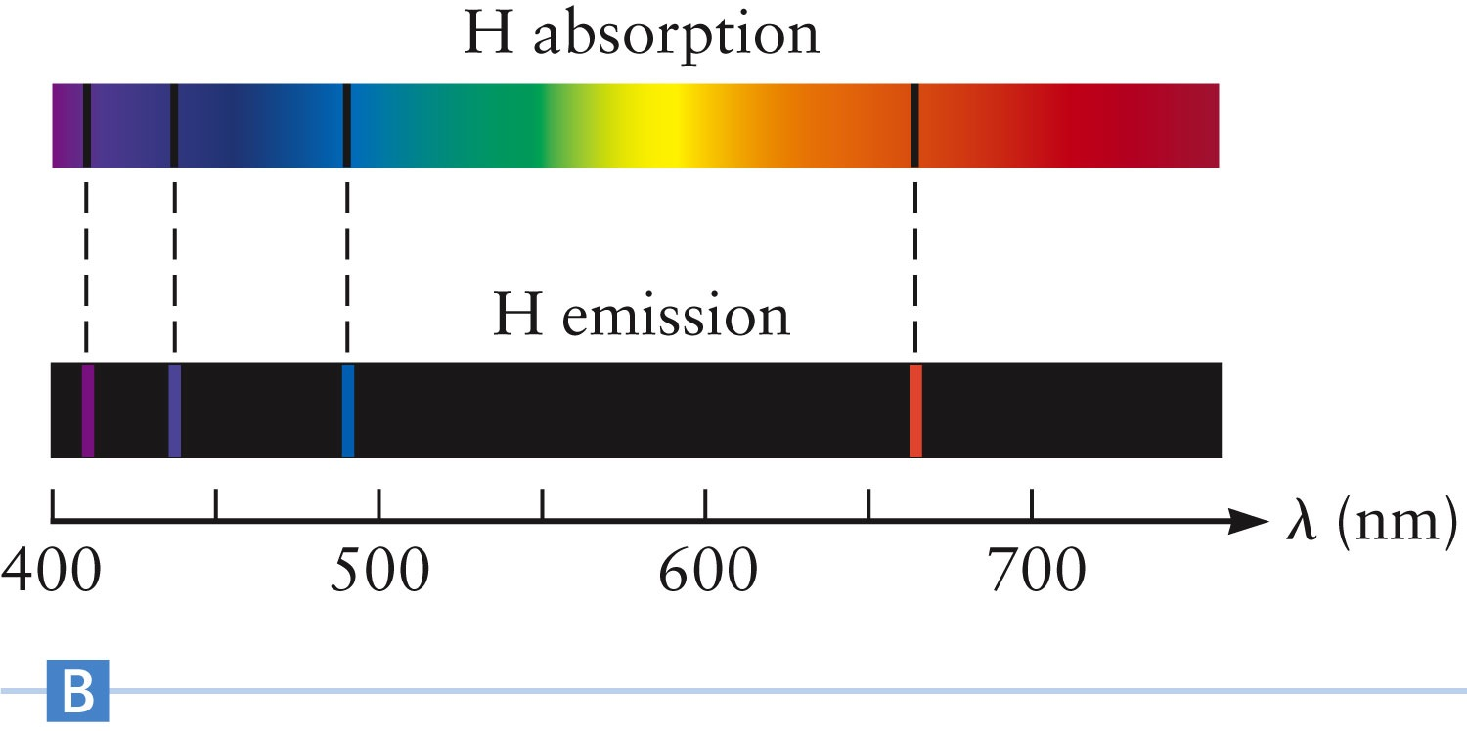
Energy Levels
Each allowed orbit is a quantum state of the electron
E₁ is the ground state
  The state of lowest possible energy for the atom
Other states are excited states
Photons are emitted when electrons fall from higher to lower states
When photons are absorbed, the electron undergoes a transition to a higher state

Slide 5
Angular Momentum and r
To determine the allowed values of the radius, r, Bohr proposed that the orbital angular momentum of the electron could only have certain values
  n = 1, 2, 3, … is an integer and h is Planck’s constant
Combining this with the orbital motion of the electron, the radii of allowed orbits can be found
Section 29.3

Slide 6
Values of r
The only variable is n
  The other terms in the equation for r are constants
The orbital radius of an electron in a hydrogen atom can have only these values
  Shows the orbital radii are quantized
The smallest value of r corresponds to n = 1
  This is called the Bohr radius of the hydrogen atom and is the smallest orbit allowed in the Bohr model
  For n = 1, r = 0.053 nm
Section 29.3

Slide 7
Problem 2:
In a previous problem 1 we used an approximate orbital radius r = 1.0 ×10⁻¹⁰ m for the hydrogen atom as estimated from measurements of the atomic spacing in molecules and solids. Calculate r from the Bohr model for the lowest three energy levels, that is the levels corresponding to n = 1, 2, and 3.

Slide 8
Energy Values
The energies corresponding to the allowed values of r can also be calculated
The only variable is n, which is an integer and can have values n = 1, 2, 3, …
Therefore, the energy levels in the hydrogen atom are also quantized
For the hydrogen atom, this becomes
Section 29.3

Slide 9
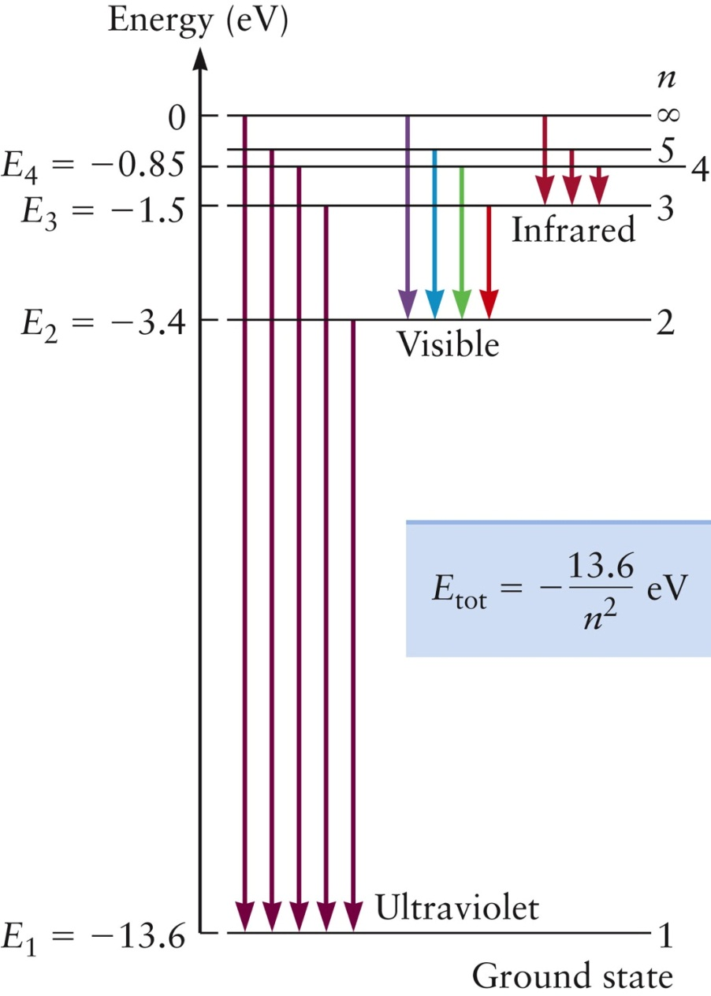
Energy Level Diagram for Hydrogen
The negative energies come from the convention that PE_{elec} = 0 when the electron is infinitely far from the proton
The energy required to take the electron from the ground state and remove it from the atom is the ionization energy
The arrows show some possible transitions leading to emissions of photons
Section 29.3

Slide 10
Problem Based Learning
1.Wavelength of Balmer H_{α} line is 6563 Angstroms. Calculate the wavelength of H_{β}.
2. A beam of electrons is used to bombard gaseous Hydrogen. What is the minimum
energy in electron volts the electrons must have if the first number of the Balmer
series corresponding to a transition from n₂ = 3 state to n₁ = 2 state to be emitted?
3. Calculate the energy required to create a vacancy in,
K shell of copper atom?
L shell of copper atom?, given ionization potential of H atom = 13.6 eV
for Copper Z = 29.

Slide 11
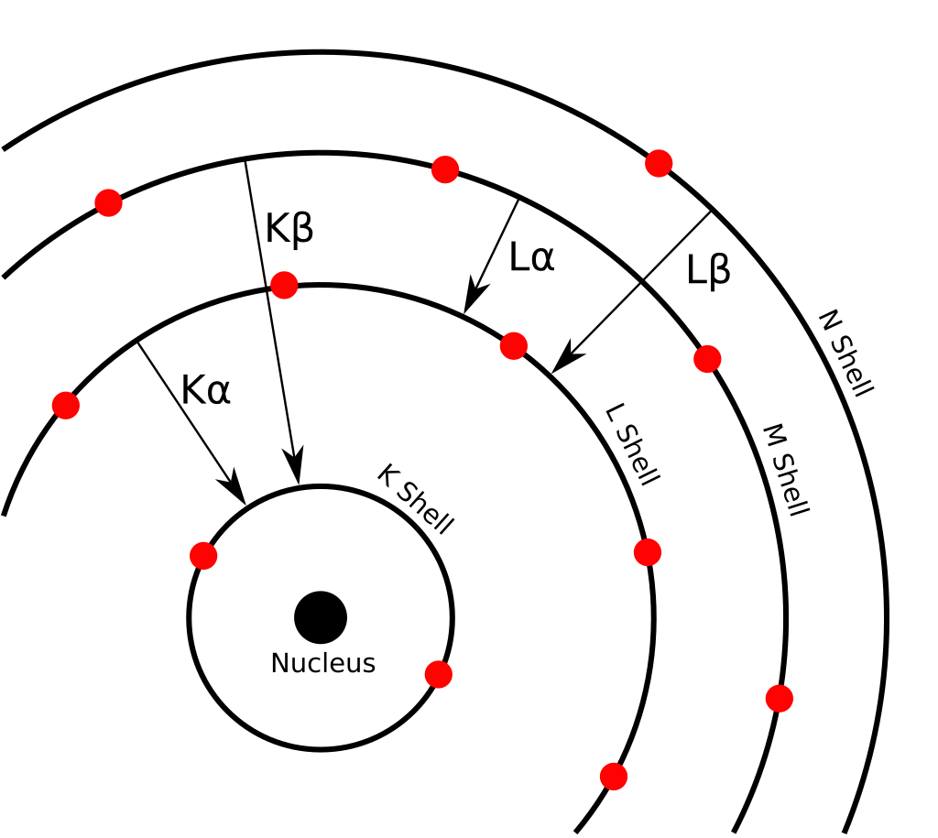
X-Rays from Atoms
The highest photon energy available in a hydrogen atom is in the ultraviolet part of the electromagnetic spectrum
Other atoms can emit much more energetic photons
Many applications use X-ray photons obtained from an electron transition from E₂ to E₁ in heavier atoms
  These are called K_{α} X-rays

Slide 12
How X-rays produce?
Characteristic X-rays are produced when an element is bombarded with high-energy particles, which can be photons, electrons or ions (such as protons).
When the incident particle strikes a bound electron (the target electron) in an atom, the target electron is ejected from the inner shell of the atom.

Slide 13
Quantized Angular Momentum
Bohr’s suggestion that the angular momentum of the electron is quantized was completely new
The assumption of quantized angular momentum can be understood in terms of de Broglie’s theory
  Which came about 10 years after Bohr made the assumption
De Broglie stated that electrons have a wave character, with a wavelength of λ = h / p
Section 29.3

Slide 14
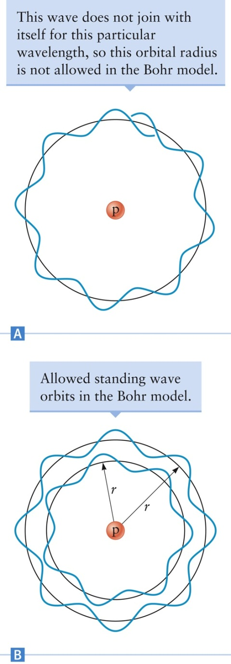
Bohr and de Broglie
The allowed electron orbits in the Bohr model correspond to standing waves that fit into the orbital circumference
Since the circumference has to be an integer number of wavelengths, 2 π r = n λ
This leads to Bohr’s condition for angular momentum

Slide 15
Problems with Bohr’s Model
The Bohr model was successful for atoms with one electron
  H, He⁺, etc.
The model does not correctly explain the properties of atoms or ions that contain two or more electrons
Physicists concluded that the Bohr model is not the correct quantum theory
  It was a “transition theory” that help pave the way from Newton’s mechanics to modern quantum mechanics
Section 29.3

Slide 16
Modern Quantum Mechanics
Modern quantum mechanics depends on the ideas of wave functions and probability densities instead of mechanical ideas of position and motion
To solve a problem in quantum mechanics, you use Schrödinger’s equations
  The solution gives the wave function, including its dependence on position and time
Four quantum numbers are required for a full description of the electron in an atom
  Bohr’s model used only one
Section 29.4

Slide 17
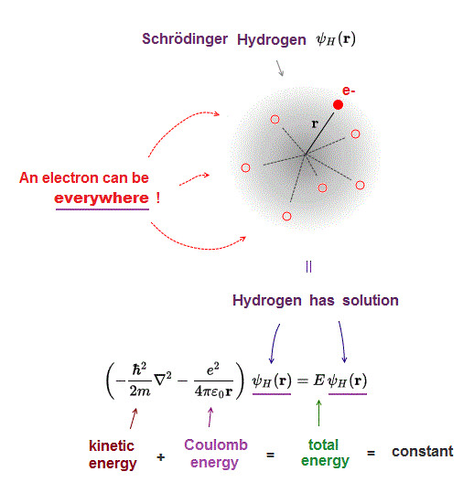
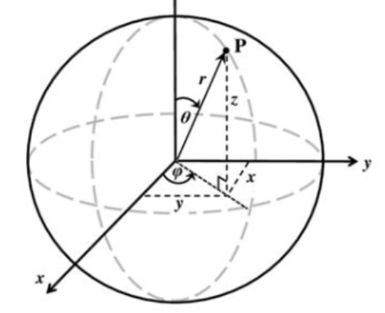
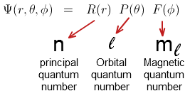
Schrödinger’s equation

Slide 18
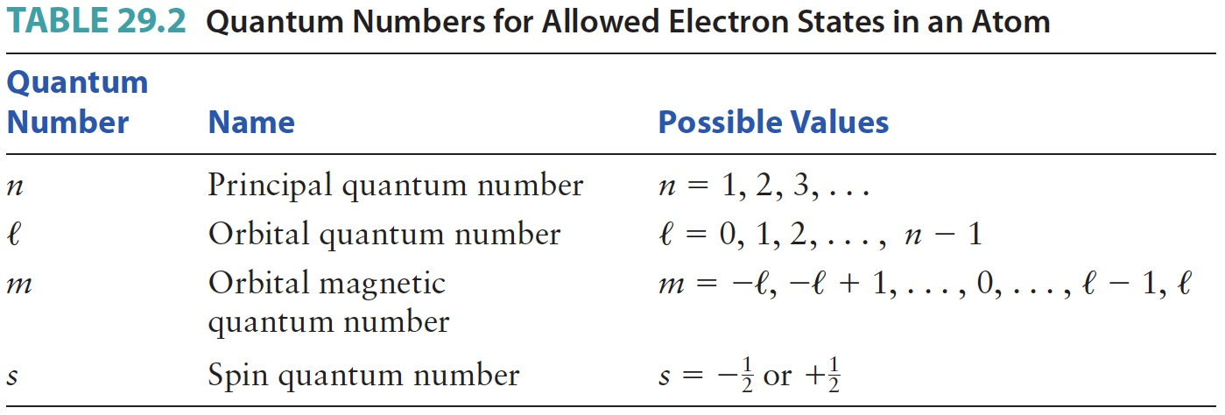
Quantum Numbers, Summary
Section 29.4

Slide 19
Principle Quantum Number
n is the principle quantum number
  It can have values n = 1, 2, 3, …
  It is roughly similar to Bohr’s quantum number
  As n increases, the average distance from the electron to the nucleus increases
  States with a particular value of n are referred to as a “shell”
Section 29.4

Slide 20
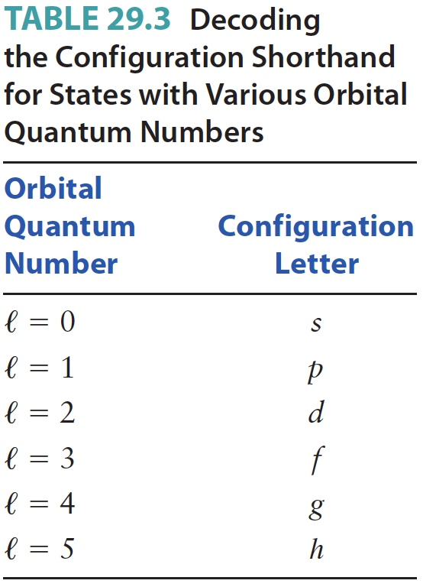
Orbital Quantum Number
ℓ is the orbital quantum number
  Allowed values are ℓ = 0, 1, 2, … n - 1
  The angular momentum of the electron is proportional to ℓ
    States with ℓ = 0 have no angular momentum
  See the table for shorthand letters for various ℓ values
Section 29.4

Slide 21
Orbital Magnetic Quantum Number
m is the orbital magnetic quantum number
  It has allowed values of m = - ℓ, -ℓ + 1, … , -1, 0, 1 … , ℓ
  You can think of m as giving the direction of the angular momentum of the electron in a particular state
Section 29.4

Slide 22
Spin Quantum Number
s is the spin quantum number
  s = + ½ or – ½
    These are often referred to as “spin up” and “spin down”
  This gives the direction of the electron’s spin angular momentum
Section 29.4

Slide 23
Electron Shells and Probabilities
A particular quantized electron state is specified by all four of the quantum number n, ℓ, m and s
The solution of Schrödinger’s equation also gives the wave function of each quantum state
  From the wave function, you can calculate the probability for finding the electron at different locations around the nucleus
Plots of probability distributions for an electron are often called “electron clouds”
Section 29.4

Slide 24
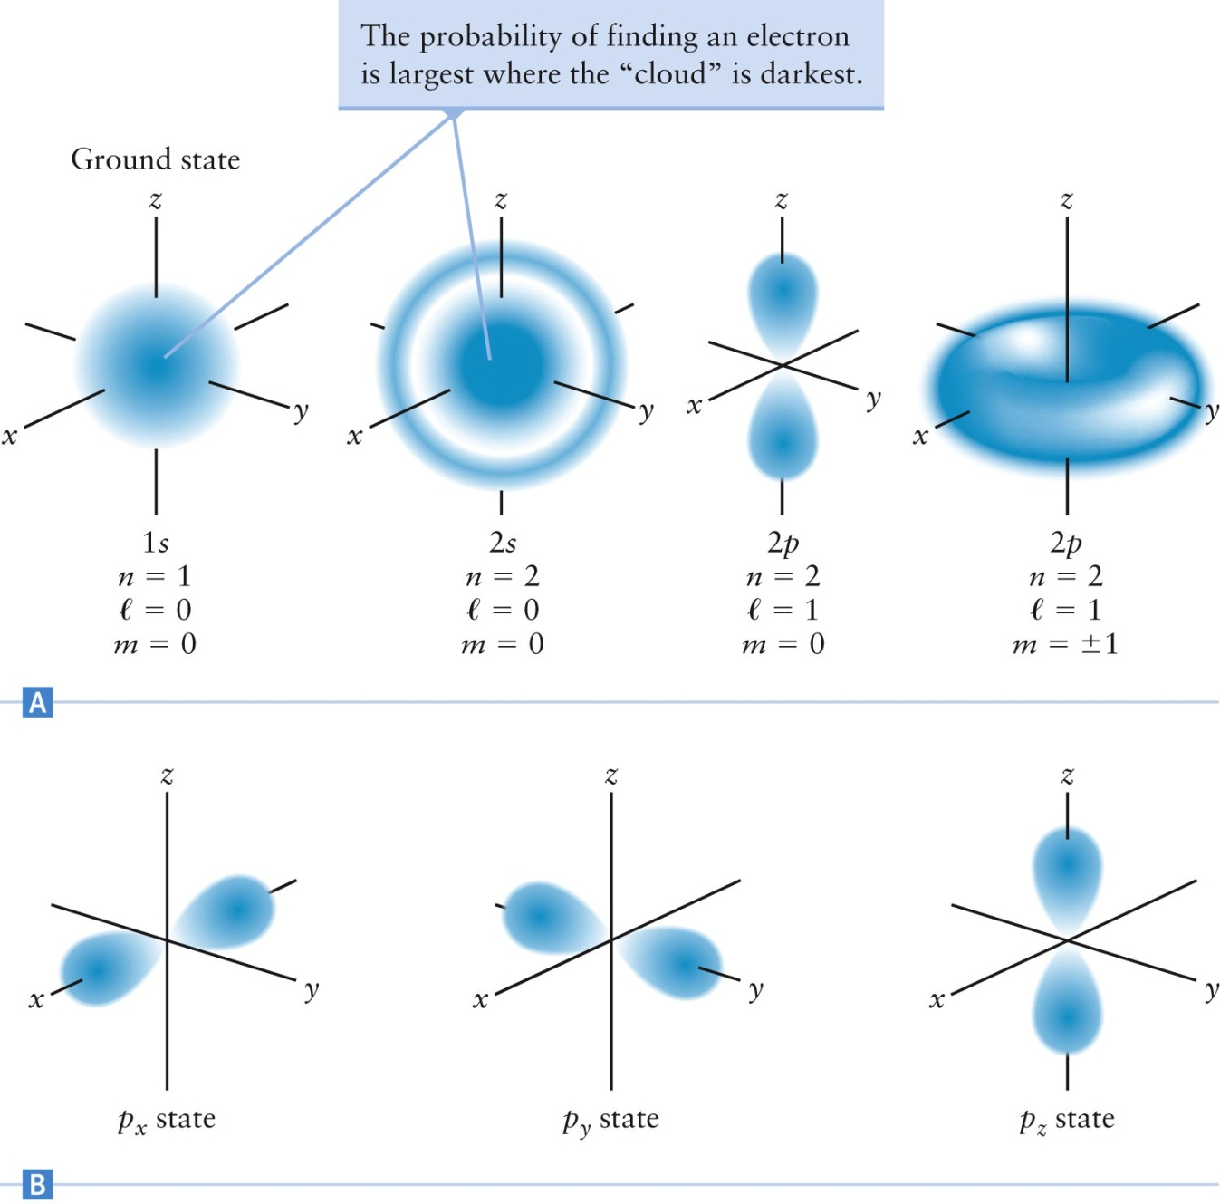
Electron Clouds

Slide 25
Multielectron Atoms
The electron energy levels of multielectron atoms follow the same pattern as hydrogen
  Use the same quantum numbers
The electron distributions are also similar
There are two main differences between hydrogen and multielectron atoms
  The values of the electron energies are different for different atoms
  The spatial extent of the electron probability clouds varies from element to element
Section 29.5

Slide 26
Pauli Exclusion Principle
Each quantum state can be occupied by only one electron
  Each electron must occupy its own quantum state, different from the states of all other electrons
This is called the Pauli exclusion principle
Each electron is described by a unique set of quantum numbers
Section 29.5

Slide 27
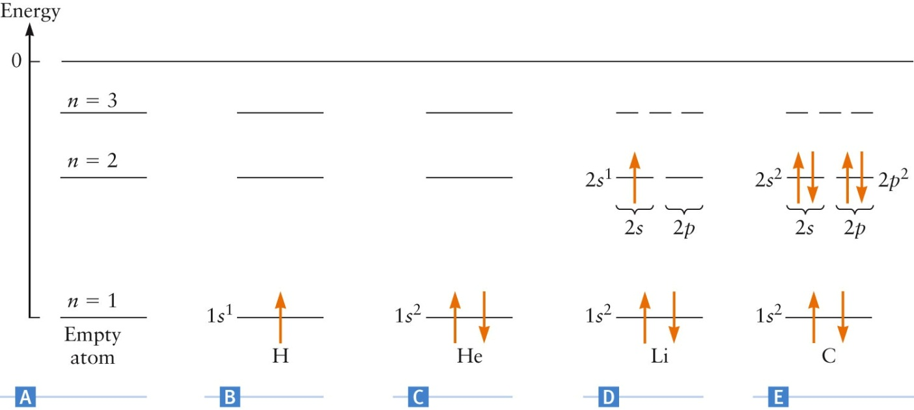
Electron Distribution
The direction of the arrow represents the electron’s spin
In C, the He electrons have different spins and obey the Pauli exclusion principle
Section 29.5

Slide 28
Electron Configuration
There is a useful shorthand notation for showing electron configurations
Examples:
  1s¹
    1 → n =1
    s → ℓ = 0
    Superscript 1 → 1 electron
    No information about electron spin
  1s²2s²2p²
    2 electrons in n = 1 with ℓ = 0
    2 electrons in n = 2 with ℓ = 0
    2 electrons in n = 2 with ℓ = 1
Section 29.5

Slide 29
Filling Energy Levels
The energy of each level depends mainly on the value of n
In multielectron atoms, the order of energy levels is more complicated
For shells higher than n = 2, the energies of subshells from different shells being to overlap
In general, the energy levels fill with electrons in the following order:
1s 2s 2p 3s 3p 4s 3d 4p 5s 4d 5p 6s 4f
Section 29.5

Slide 30
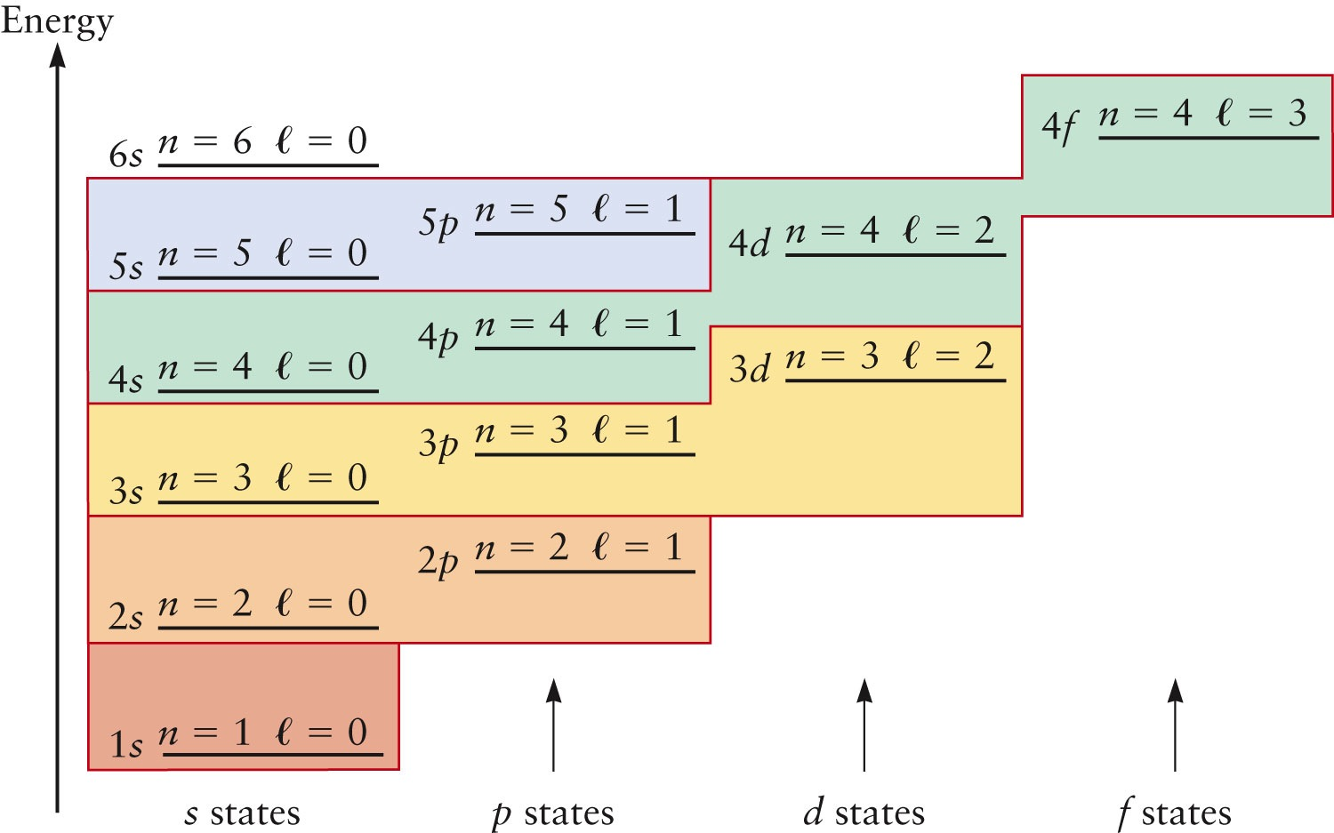
Order of Energy Levels

