Slide 1
Day 02

Slide 2
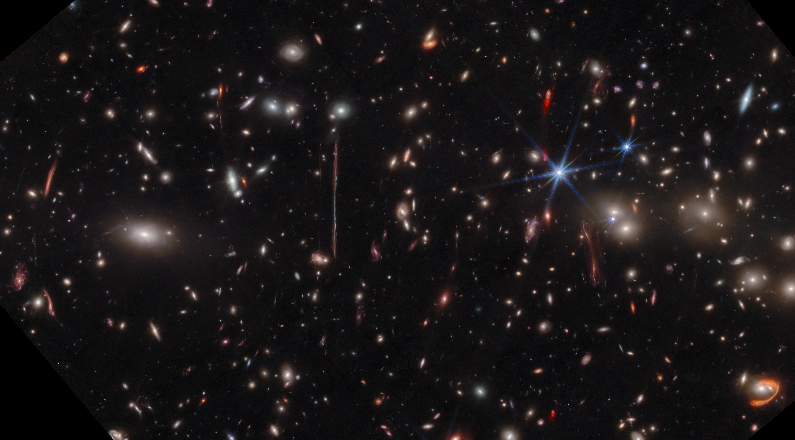
El Gordo.
James Web Space Telescope Image:
the most massive galaxy cluster from back when the Universe was just 6.4 billion years old, less than half its present age: El Gordo.
With a total mass of about 3 quadrillion (3 × 10^15) suns, including both normal and dark matter, it’s the largest collection of mass at such early times ever seen.

Slide 3

The world of our experience is not the whole story:
The way we perceive time, space, and objects may not be the fundamental nature of reality, especially at the quantum level, where properties are not definite until observed.

Slide 4
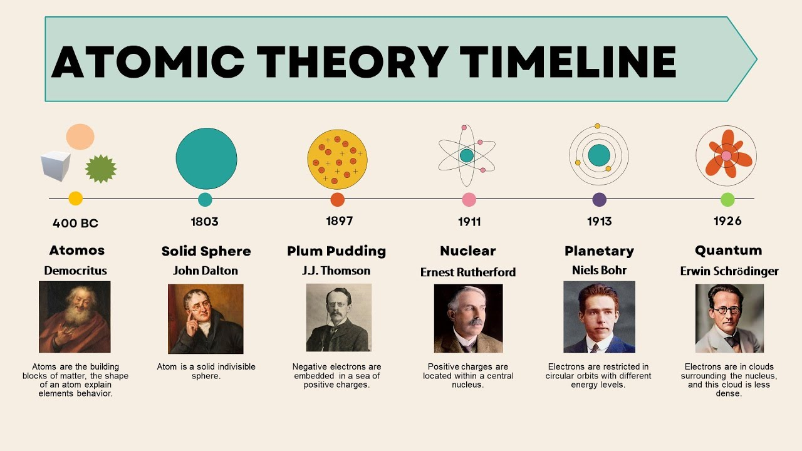

Slide 5
Particle Review
Electrons
  Carry charge of –e
Protons
  Carry charge of +e
Neutrons
  Carry no net electrical charge
  Mass approximately the same as the proton
Ideas of quantum theory need to be applied to understand the structure of the atom

Slide 6
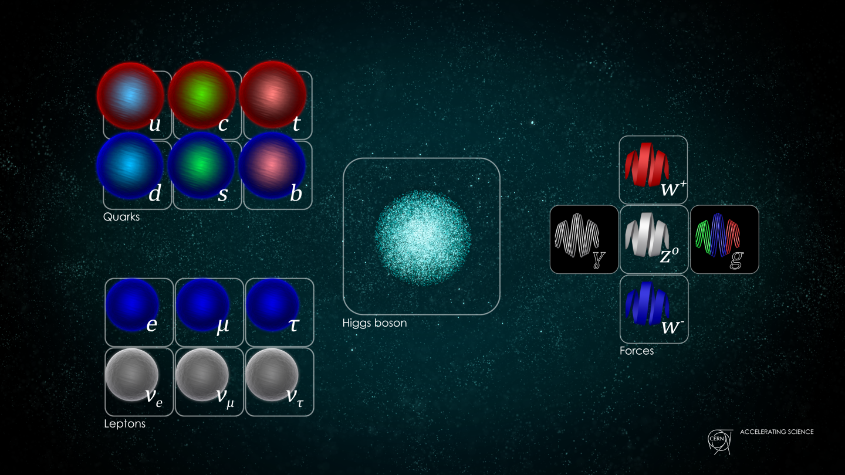
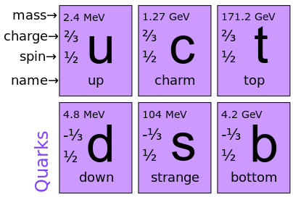
Particle Review

Slide 7
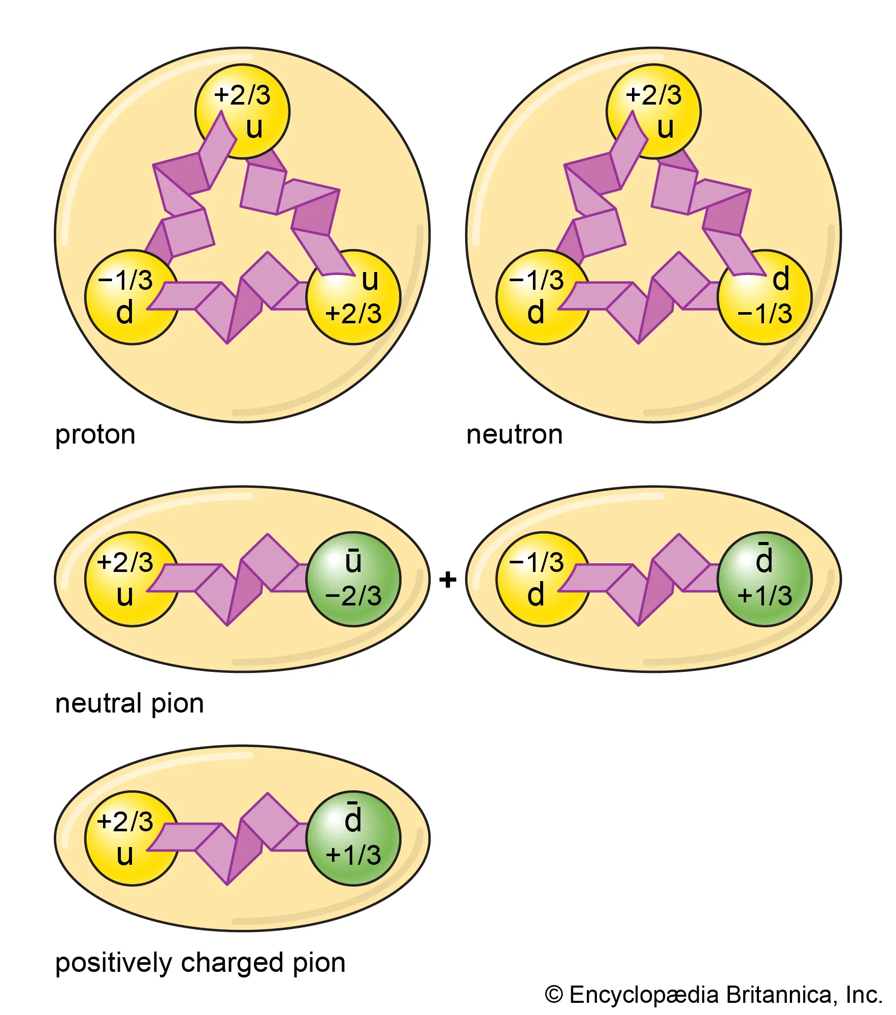
Particle Review

Slide 8
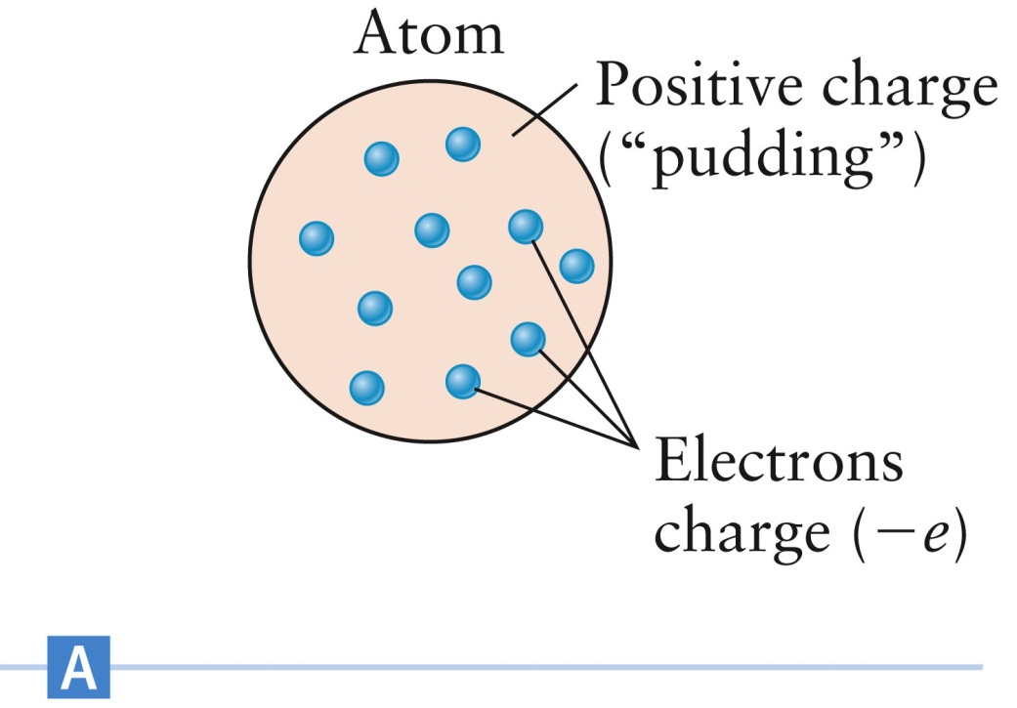
Plum Pudding Model- J.J.Thompson
Electrons were the first building-block particles to be discovered
The model suggested that the positive charge of the atom is distributed as a “pudding” with electrons suspended throughout the “pudding”

Slide 9
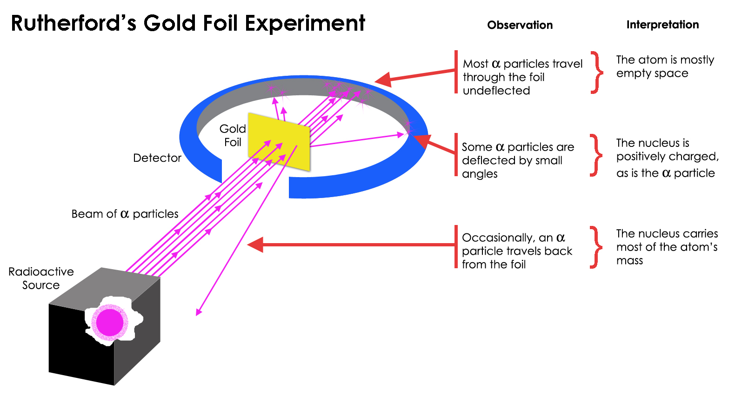
Finding Nucleus- Rutherford

Slide 10
Rutherford’s scattering of α particles
b
N
O
θ
φ
p
The alpha particles were emitted from the radioactive substances such as radium or polonium. An alpha particle is a doubly ionized helium atoms or ions with two units of positive charge, mass number is equal to 4.

Slide 11
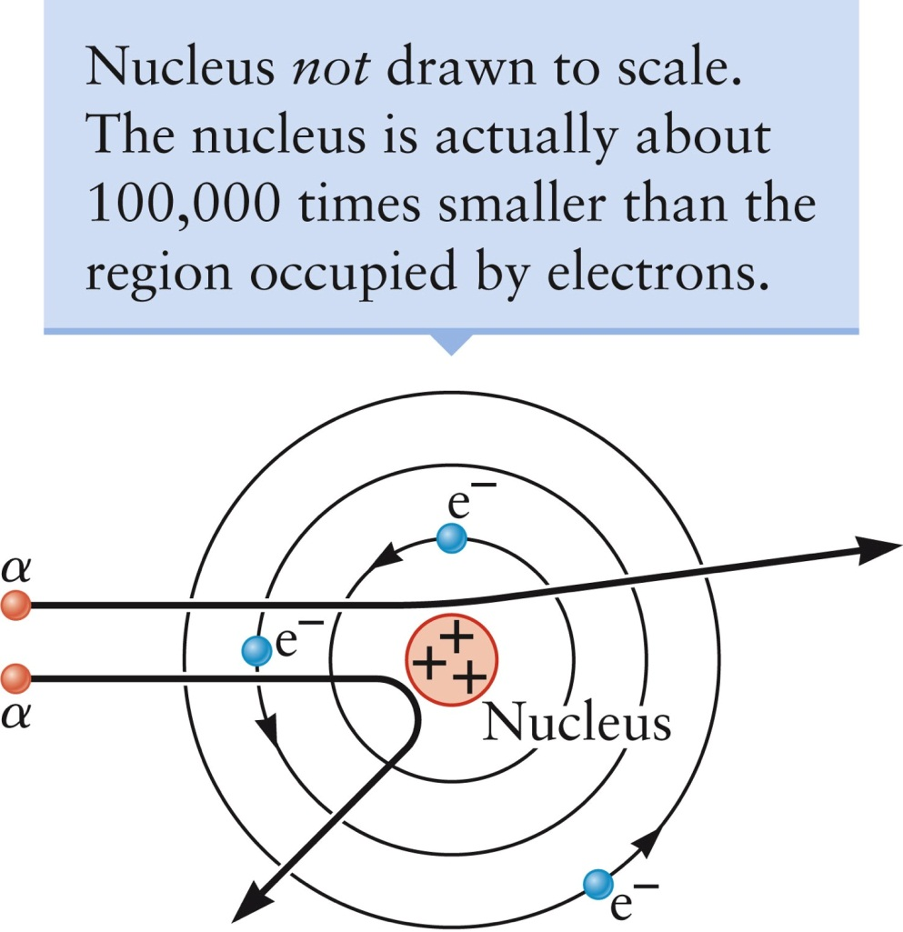
Planetary Model-Rutherford
Most of the alpha particles did pass freely through the atom
A small number of alpha particles were actually deflected through very large angles
  Some bounced backward

Slide 12
Planetary Model, cont.
The reaction of the alpha particle could not be explained by the plum-pudding model
Rutherford realized that all the positive charge in an atom must be concentrated in a very small volume
  The mass and density of the positive charge was about the same as the alpha particle
Most alpha particles missed this dense region and passed through the atom
Occasionally an alpha particle collided with the dense region, giving it a large deflection
He concluded that atoms contain a nucleus that is positively charged and has a mass much greater than that of the electron

Slide 13
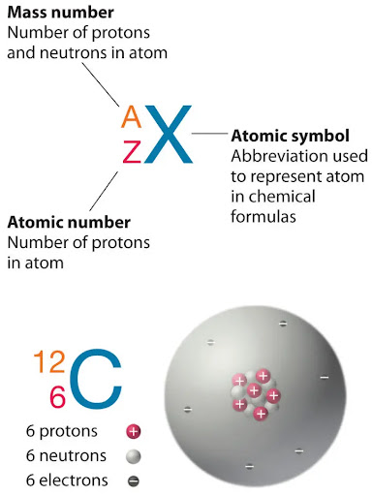
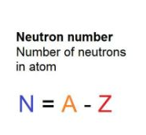
Atomic Number and Neutrons

Slide 14
Planetary Model, final
Rutherford suggested that the atom is a sort of miniature solar system
The electrons orbit the nucleus just as the planets orbit the sun
  The electrons must move in orbits to avoid falling into the nucleus as a result of the electric force
The atomic nucleus contains protons
  The charge on a proton is +e
Since the total charge on an atom is zero, the number of protons must equal the number of electrons

Slide 15
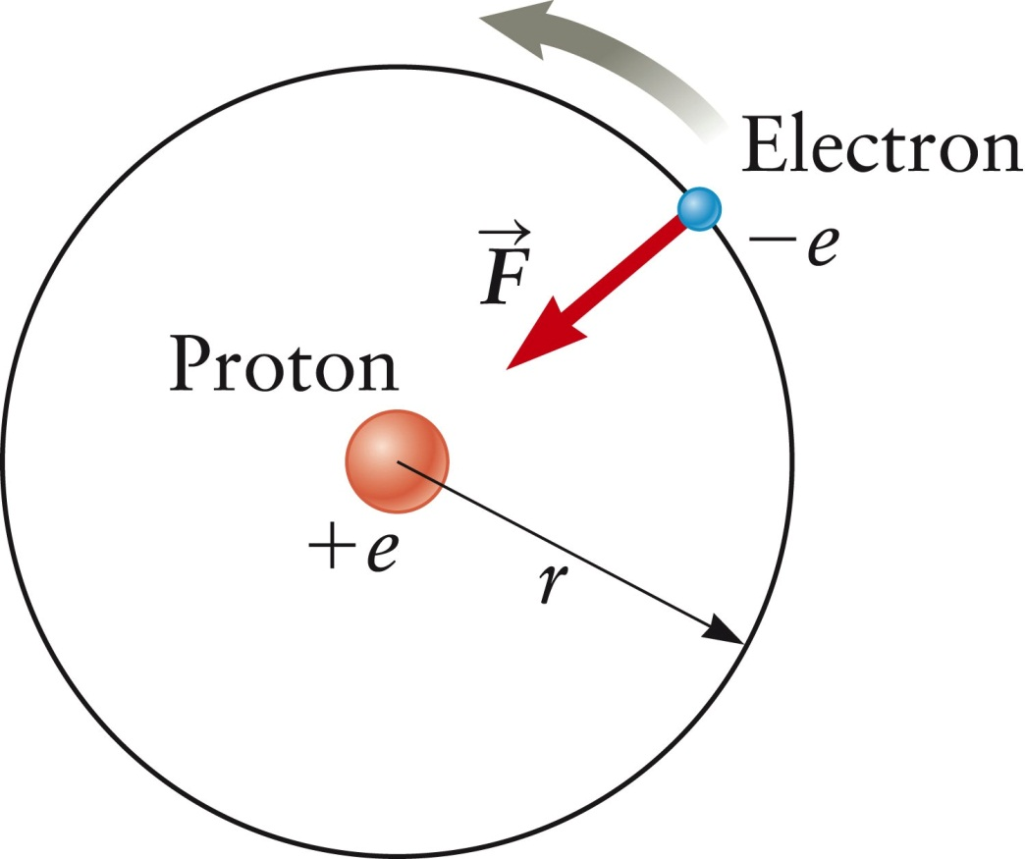
Energy of Orbiting Electron vs measured ionization energy
Find the kinetic energy of the orbiting electron.

Slide 16
Problem based learning (PBL1):
Calculate the total energy required to remove the electron from the proton, of the hydrogen atom. Assume the electron’s orbit has a radius
r = 1.0 ×10⁻¹⁰ m. Find the electric potential energy in this model of the hydrogen atom. What is the change in this potential energy when the atom is ionized?

Slide 17
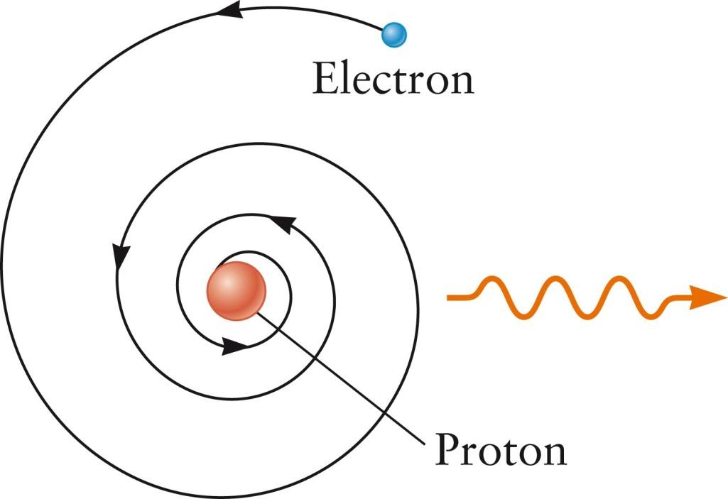
Major Problem with the Planetary Model
Stability of the electron orbit
  Atoms are stable
  Atoms should not be stable in the model
There was no way to fix the planetary model to make the atom stable
Section 29.1

Slide 18
Stability Details
Since the electrons are undergoing accelerated motion, they should emit electromagnetic radiation
As the electron loses energy, it should spiral into inward to the nucleus
The atom would be inherently unstable
It should only last a fraction of a second
Section 29.1

Slide 19
Quantum Theory Solution
Quantum theory avoids the problem of unstable electrons
  It replaces orbits with discrete energy levels
Quantum theory says the electrons are not simple particles that obey Newton’s laws and spiral into the nucleus
The electron is a wave-particle described by a wave function with discrete energy levels
Electrons gain or lose energy only when they undergo a transition between energy levels
Section 29.1

Slide 20
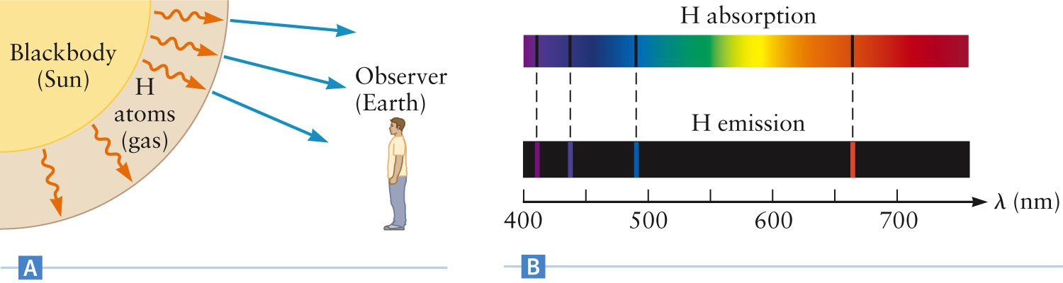
Formation of Spectra
When light from a pure blackbody source passes through a gas, atoms in the gas absorb light at certain wavelengths
The values of the wavelengths have been confirmed in the laboratory
Section 29.2

Slide 21
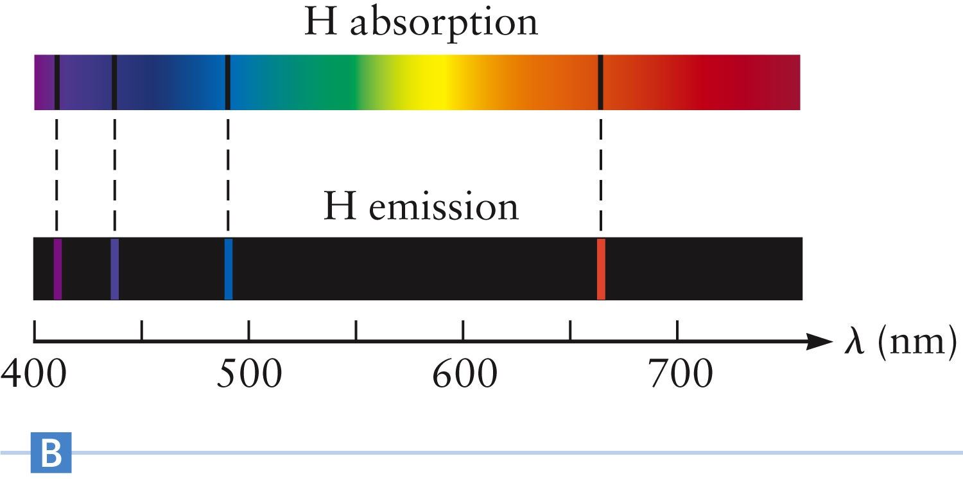
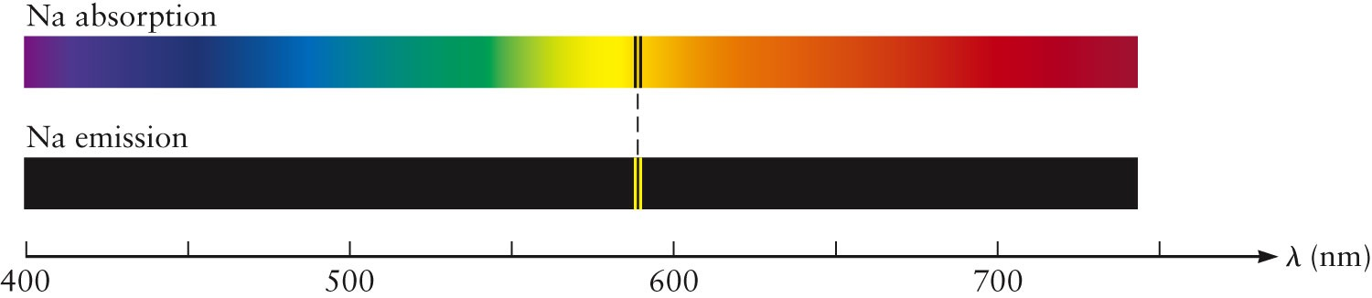
Pattern of spectral lines is different for each element

Slide 22
Questions About Spectra
Why do the lines occur at specific wavelengths?
Why do absorption and emission lines occur at the same wavelength?
What determines the pattern of wavelengths?
Why are the wavelengths different for different elements?
Section 29.2

Slide 23
Photon Energy
The energy of a photon is E_{photon} = h ƒ
Since total energy is conserved, the energy of the photon is the difference in the energy of the atom before and after emission or absorption
Since atomic emission occurs only at certain discrete wavelengths, the energy of the orbiting electron can only have certain discrete values
According to Newton’s mechanics, the radius of the electron’s orbit can have a continuous range of values
Section 29.2

Slide 24
Photon Energy and Newton
Based on Newton’s mechanics, there is no way for the planetary orbit picture to give discrete electron energies
  Energies of an orbiting electron could have a continuous range of values
  So there is no way to explain the existence of discrete spectral lines
  The problem is resolved in quantum mechanics’ explanation of the electron’s state in terms of a wave function instead of an orbit
Section 29.2

Slide 25
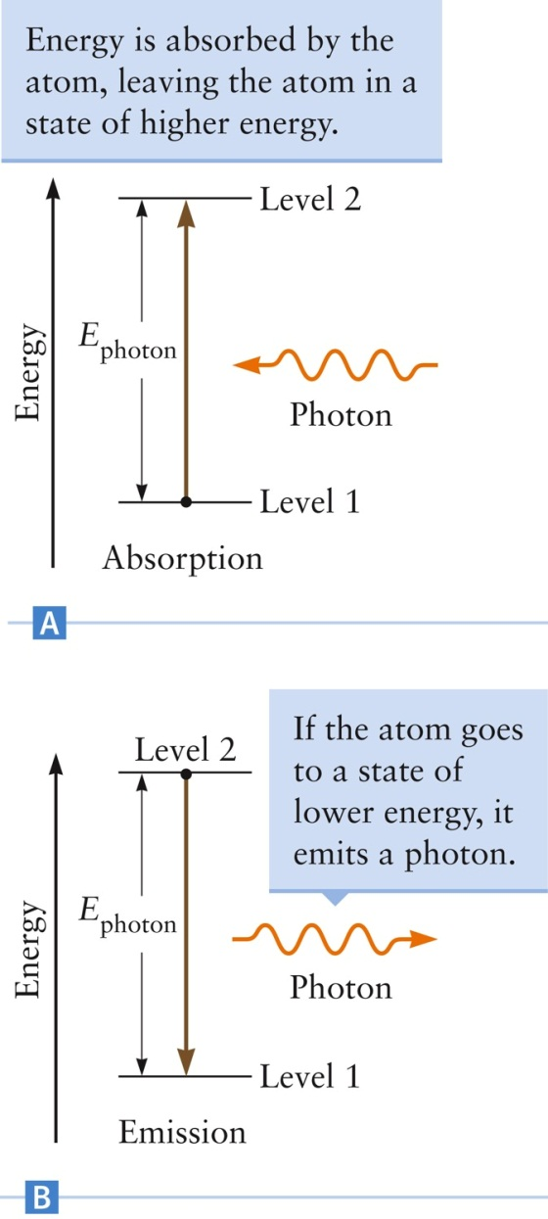
Atomic Energy Levels
The energy of an atom is quantized
The energy of an absorbed or emitted photon is equal to the difference in energy between two discrete atomic energy levels
The frequencies of the lines give the spacing between the atom’s energy levels
Explained the experimental evidence of discrete spectral lines
Section 29.2

Slide 26
Ideas In Bohr’s Model
Circular electron orbits
  For simplification
Used hydrogen
  Simplest atom
Postulated only certain electron orbits are allowed
  To explain discrete spectral lines
  Only specific values of r are allowed
  Then only specific energies are allowed based on the values of r
Energy level diagrams can be used to show absorption and emission of photons
Explained the experimental evidence
Section 29.3

Slide 27
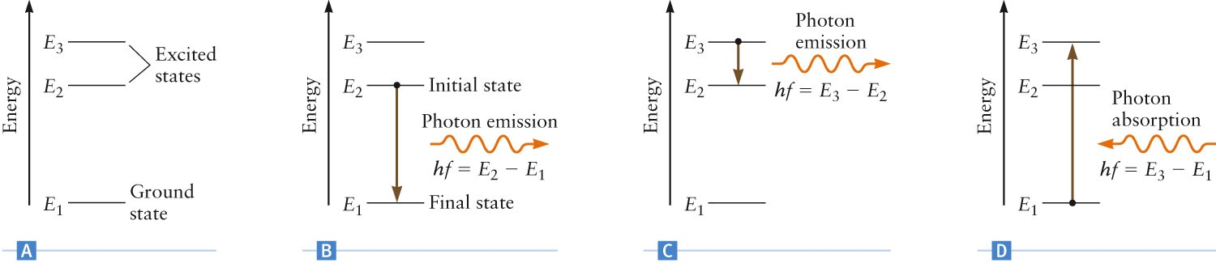
Energy Levels
Each allowed orbit is a quantum state of the electron
E₁ is the ground state
  The state of lowest possible energy for the atom
Other states are excited states
Photons are emitted when electrons fall from higher to lower states
When photons are absorbed, the electron undergoes a transition to a higher state

Slide 28
Angular Momentum and r
To determine the allowed values of the radius, r, Bohr proposed that the orbital angular momentum of the electron could only have certain values
  n = 1, 2, 3, … is an integer and h is Planck’s constant
Combining this with the orbital motion of the electron, the radii of allowed orbits can be found
Section 29.3

Slide 29
Values of r
The only variable is n
  The other terms in the equation for r are constants
The orbital radius of an electron in a hydrogen atom can have only these values
  Shows the orbital radii are quantized
The smallest value of r corresponds to n = 1
  This is called the Bohr radius of the hydrogen atom and is the smallest orbit allowed in the Bohr model
  For n = 1, r = 0.053 nm
Section 29.3

Slide 30
Problem 2:
In a previous problem 1 we used an approximate orbital radius r = 1.0 ×10⁻¹⁰ m for the hydrogen atom as estimated from measurements of the atomic spacing in molecules and solids. Calculate r from the Bohr model for the lowest three energy levels, that is the levels corresponding to n = 1, 2, and 3.

Slide 31
Energy Values
The energies corresponding to the allowed values of r can also be calculated
The only variable is n, which is an integer and can have values n = 1, 2, 3, …
Therefore, the energy levels in the hydrogen atom are also quantized
For the hydrogen atom, this becomes
Section 29.3

Slide 32
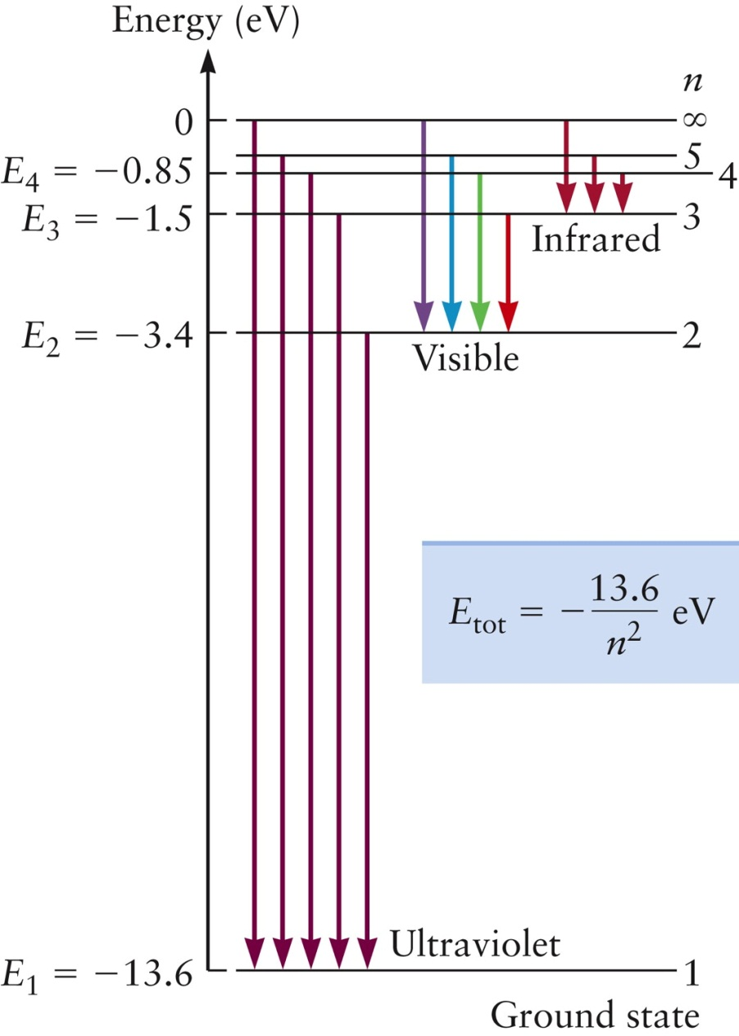
Energy Level Diagram for Hydrogen
The negative energies come from the convention that PE_{elec} = 0 when the electron is infinitely far from the proton
The energy required to take the electron from the ground state and remove it from the atom is the ionization energy
The arrows show some possible transitions leading to emissions of photons
Section 29.3

Slide 33
Quantum Theory and the Kinetic Theory of Gases
Quantum theory explains the claim that the collisions between atoms in a gas are elastic
At room temperature, the kinetic energy of the colliding atoms is smaller than the spacing between the ground and the excited states
A collision does not involve enough energy to cause a transition to a higher level
The atoms stay in their ground state
  None of their kinetic energy is converted into potential energy of the atomic electrons
Section 29.3

Slide 34
X-Rays from Atoms
The highest photon energy available in a hydrogen atom is in the ultraviolet part of the electromagnetic spectrum
Other atoms can emit much more energetic photons
May applications use X-ray photons obtained from an electron transition from E₂ to E₁ in heavier atoms
  These are called K_{α} X-rays
  See table 29.1 for the energy of K_{α} X-rays produced by some elements
Section 29.3

Slide 35
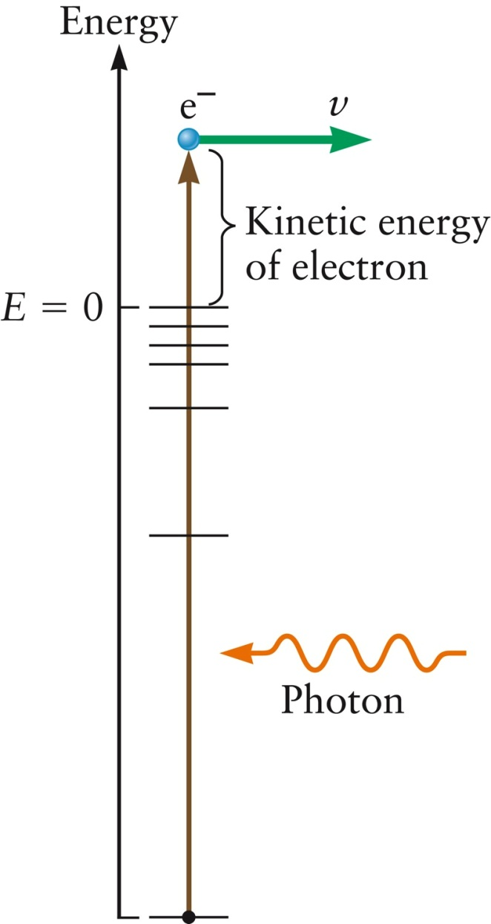
Continuous Spectrum
If an absorbed photon has more energy than is needed to ionize an atom, the extra energy goes into the kinetic energy of the ejected electron
This final energy can have a range of values and so the absorbed photon can have a range of values
This produces a continuous spectrum
Section 29.3

Slide 36
Quantized Angular Momentum
Bohr’s suggestion that the angular momentum of the electron is quantized was completely new
The assumption of quantized angular momentum can be understood in terms of de Broglie’s theory
  Which came about 10 years after Bohr made the assumption
De Broglie stated that electrons have a wave character, with a wavelength of λ = h / p
Section 29.3

Slide 37
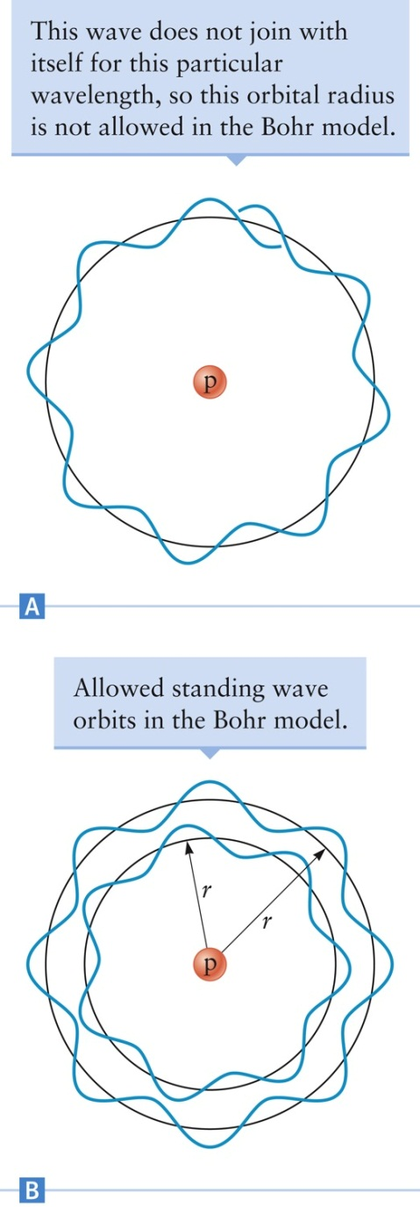
Bohr and de Broglie
The allowed electron orbits in the Bohr model correspond to standing waves that fit into the orbital circumference
Since the circumference has to be an integer number of wavelengths, 2 π r = n λ
This leads to Bohr’s condition for angular momentum
Section 29.3

Slide 38
Problems with Bohr’s Model
The Bohr model was successful for atoms with one electron
  H, He⁺, etc.
The model does not correctly explain the properties of atoms or ions that contain two or more electrons
Physicists concluded that the Bohr model is not the correct quantum theory
  It was a “transition theory” that help pave the way from Newton’s mechanics to modern quantum mechanics
Section 29.3

