Slide 1
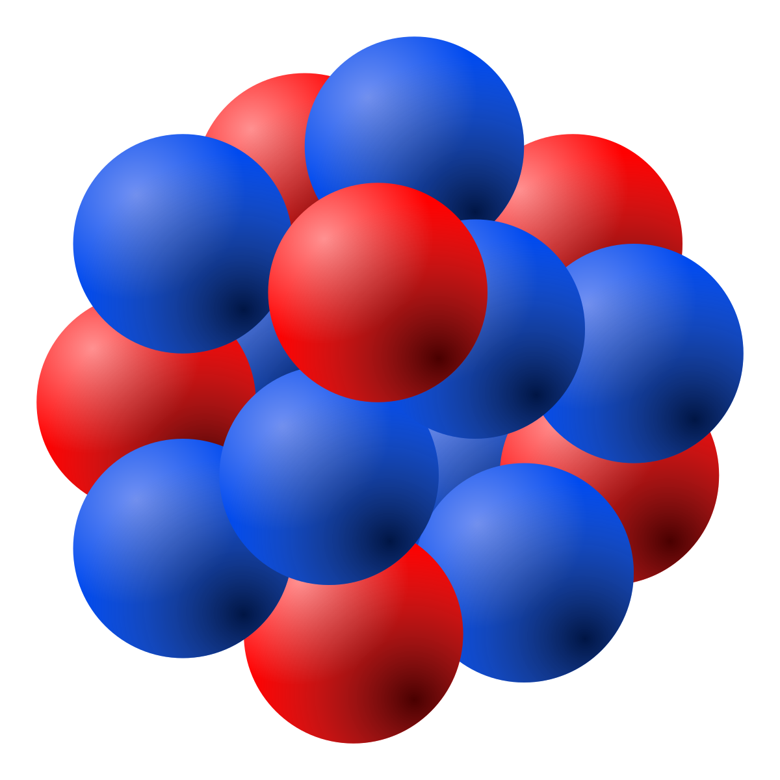
PHY 208 1.0
Nuclear Physics

Slide 2
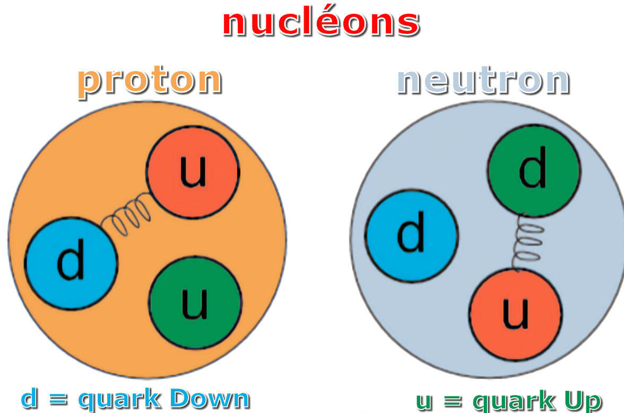
Atomic Nuclei
Every nucleus is composed of particles called protons and neutrons
Different elements have different numbers of these two particles in the nuclei
The protons and neutrons in most nuclei are bound together very tightly
  Generally can be treated as a simple, unbreakable particle in chemical reactions or atomic spectra

Slide 3
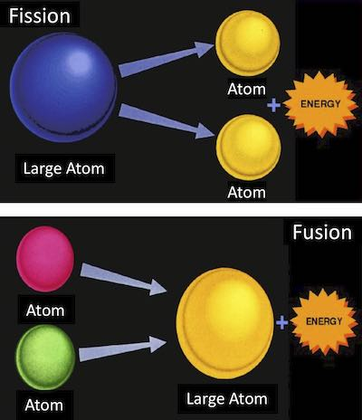
Nuclear Reactions
In a nuclear reaction, a nucleus breaks apart or is assembled
These reactions can release very large amounts of energy
Introduction

Slide 4
Structure of the Nucleus
Nuclei are composed of nucleons – protons and neutrons
Proton
  m_{p} = 1.673 x 10⁻²⁷ kg
  Positively charged
  Charge is +e
Neutron
    m_{n} = 1.675 x 10⁻²⁷ kg
    Electrically neutral
Section 30.1

Slide 5
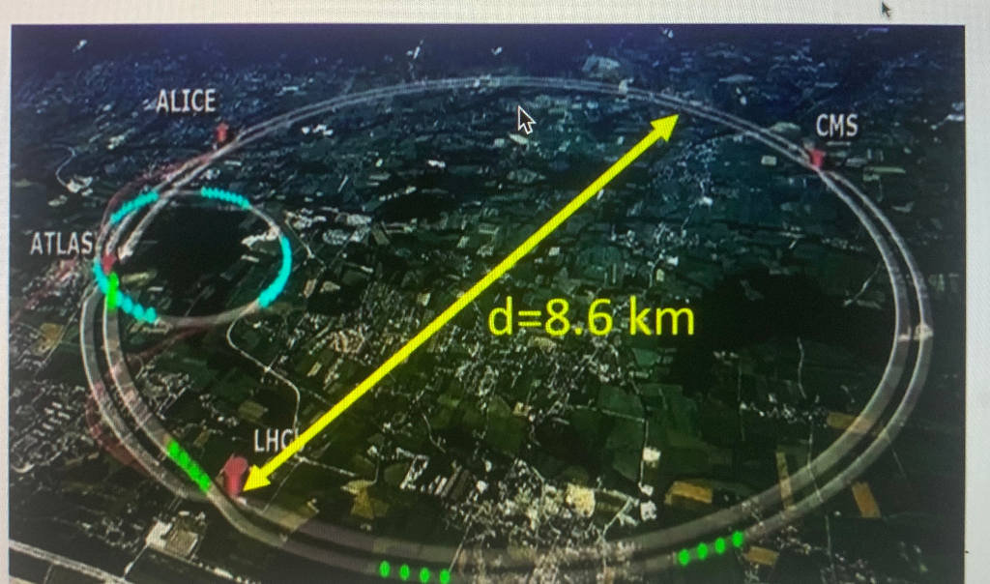
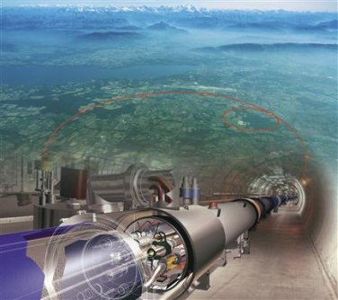
CERN(the European Organization for Nuclear Research)
Large Hadron Collider will help answer some of the fundamental open questions in physics,
basic laws governing the interactions and forces among elementary particles
the deep structure of space and time,
the interrelation between quantum mechanics and general relativity

Slide 6
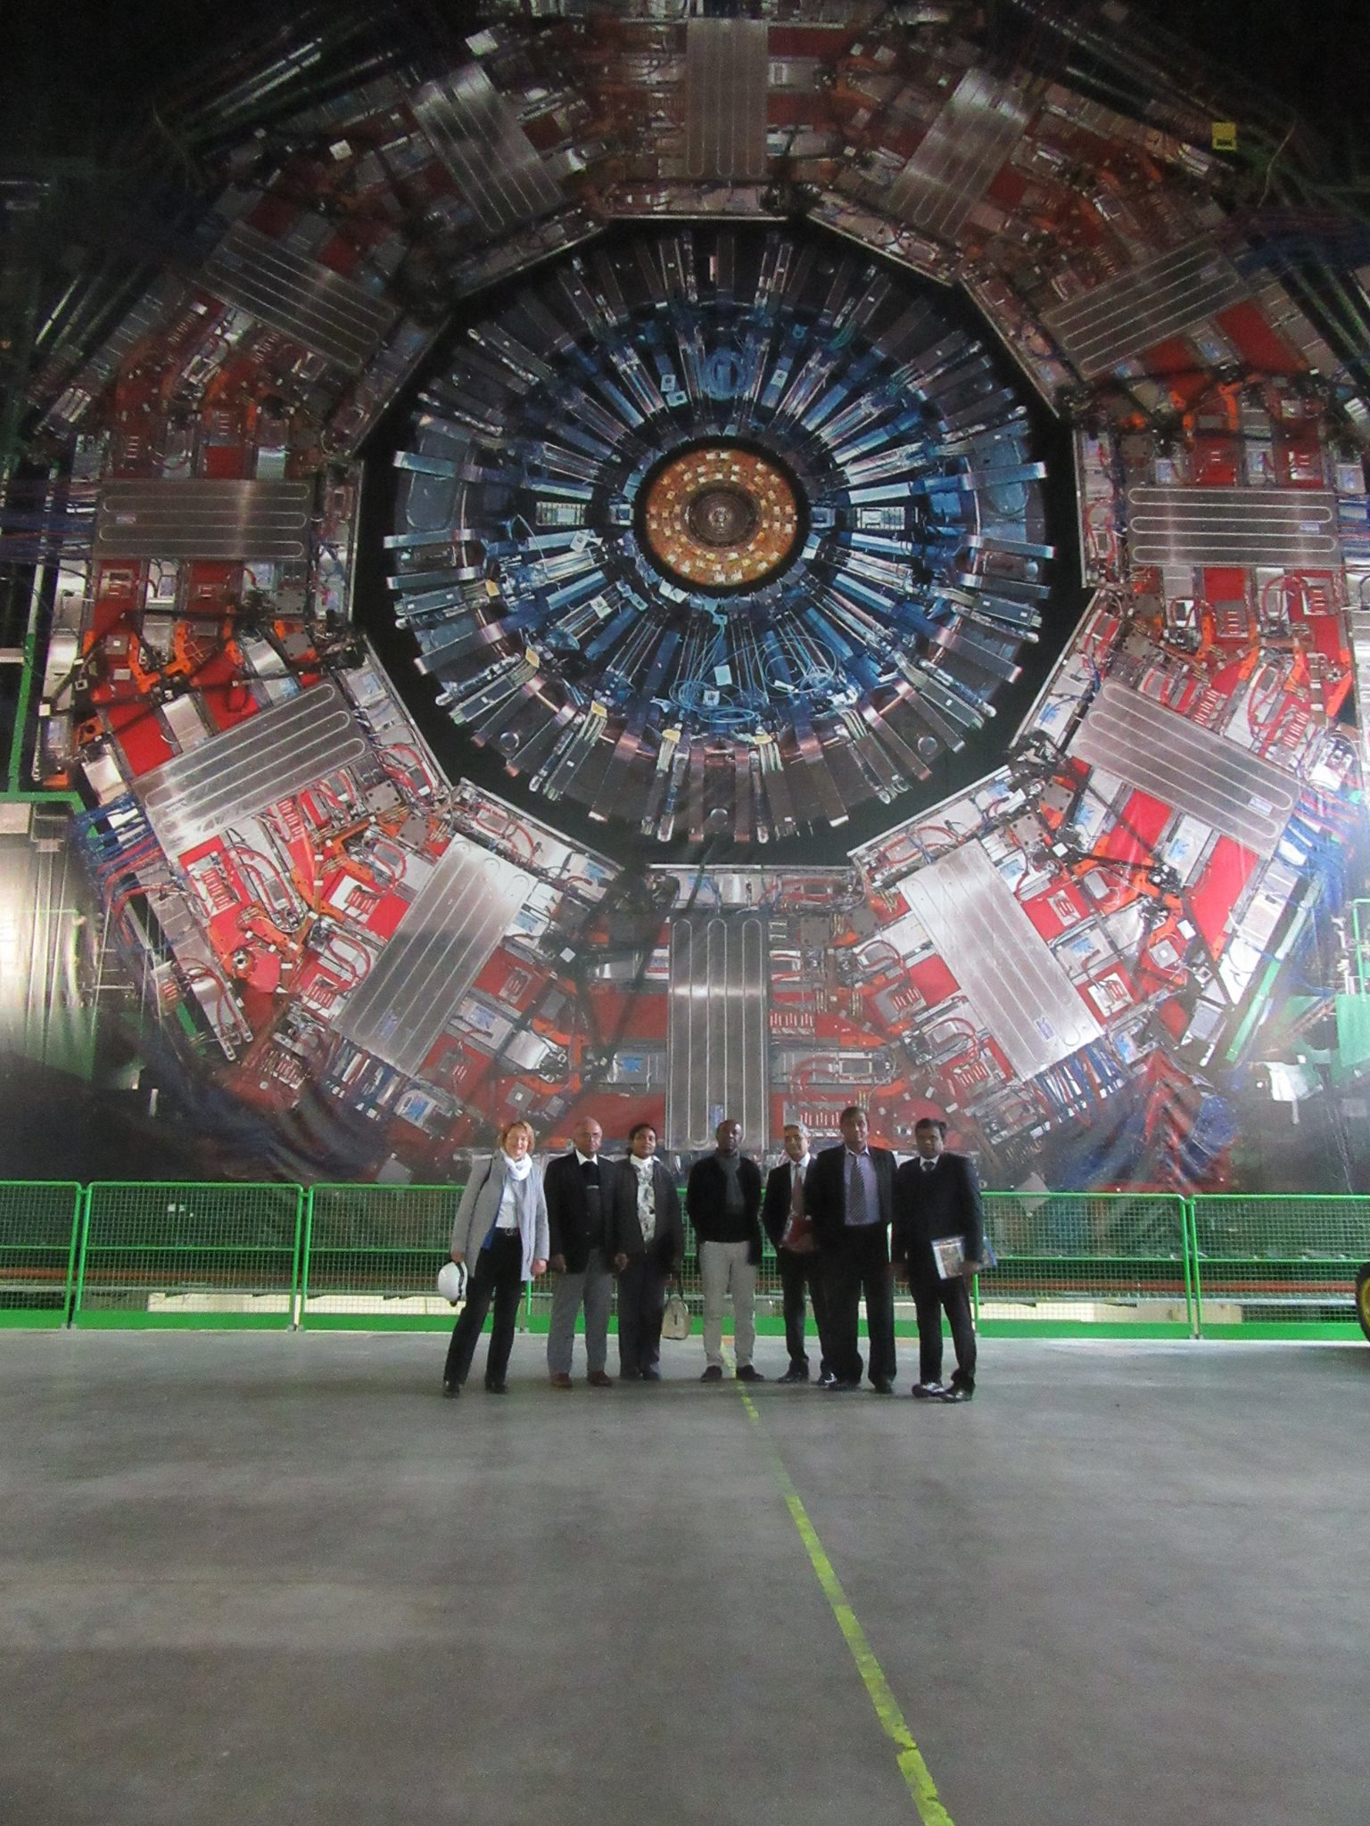

at CERN-CMS.
2017 May

Slide 7


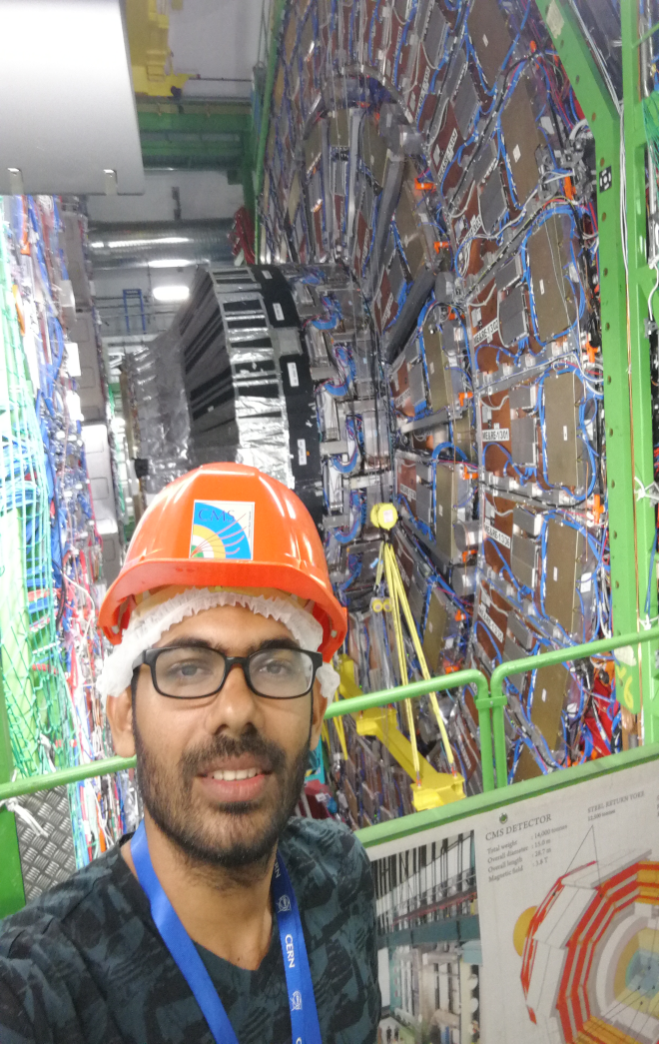
Summer Intern scholars from USJ at CERN
during 2017-2023
2017 Summer Student
2018 Summer Student
2019 Summer Student

Slide 8


2018-PhD Scholar from USJP
2022 Summer Student
2018-PhD student-Nimantha
Perera

Slide 9
Atomic Number (Z)
Every nucleus can be specified by the numbers of protons and neutrons it contains
The number of protons is called the atomic number
  Symbolized by Z
  Each element has a particular and unique number of protons
  Therefore, each has a characteristic value of Z
Z also equals the number of electrons in an atom
  Since atoms are electrically neutral, the number of electrons will equal the number of protons
Section 30.1

Slide 10
Mass Number (A)
The number of neutrons is symbolized by N
  The value of N for a particular element can vary
The mass number, A, is the sum of the number of protons and neutrons
Notation:
  X is the symbol for the element
  A = Z + N

Slide 11
Example:
  The element is He
  The mass number, A, is 4
  The atomic number, Z, is 2
  Therefore, there are 2 neutrons in the nucleus

Slide 12
Isotopes (Same Z, but different N)
Elements with various numbers of neutrons are called isotopes
  All isotopes of a particular element will have the same number of protons and electrons
    Same Z, but different N
  The chemical properties are determined by the bonding electrons, so the chemical properties of different isotopes of a given element are essentially identical
Example:
Section 30.1

Slide 13
Isotopes and Atomic Mass
The atomic mass of an atom is the mass of the nucleus plus Z electrons
The atomic masses of different isotopes are different
The periodic table contains an average value of the atomic mass for each element based on the natural abundance of each isotope
The value listed in the periodic table is the mass in grams of 1 mole of atoms
Section 30.1

Slide 14
Isotopes, Isobars, and Isotones
Isotopes: The atoms having same atomic number but different atomic mass number are called Isotope.
Isobars: Nuclides having the same mass number but having the different Proton/Atomic number are called Isobar.
Isotones: Atoms of different elements having different mass number and different atomic number but same neutron number are called Isotones.
⁴⁰S, ⁴⁰Cl, ⁴⁰Ar, ⁴⁰K, and ⁴⁰Ca.
³⁶S, ³⁷Cl, ³⁸Ar, ³⁹K, and ⁴⁰Ca – all contains 20 neutrons
boron-12 and carbon-13 nuclei

Slide 15
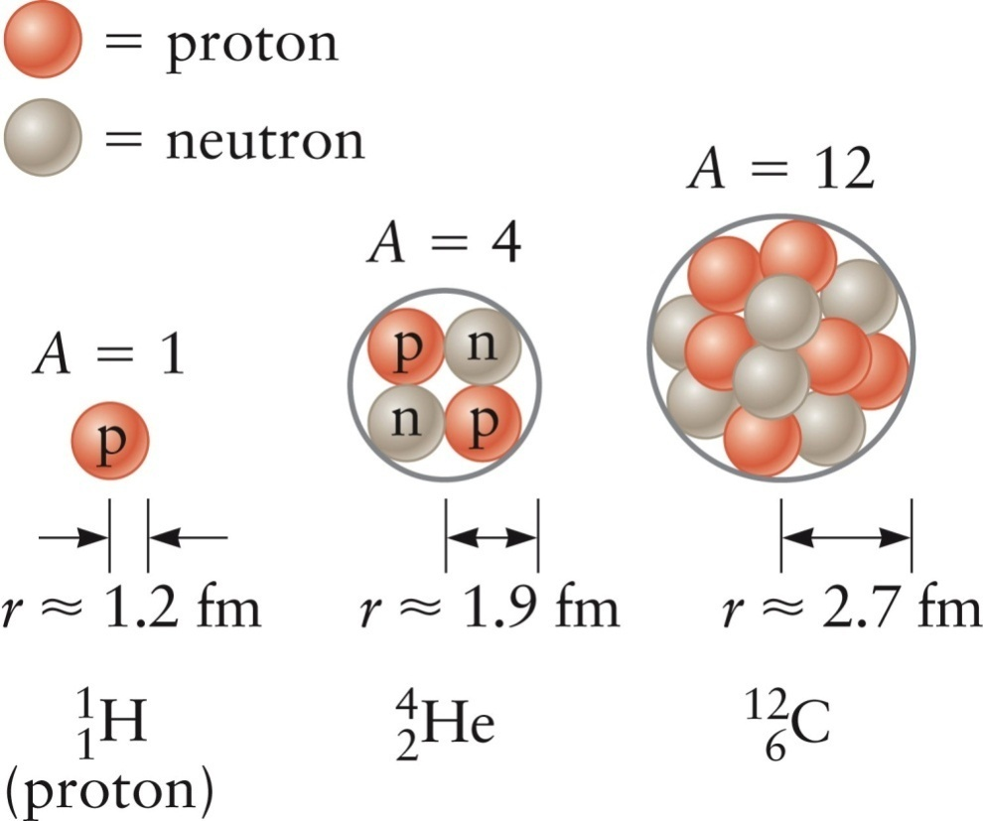
Size of the Nucleus, cont.
Most nuclei have an approximately spherical shape
The radius, r, depends on the number of nucleons it contains
r_{o} ≈1.2 fm = 1.2 x10⁻¹⁵ m
Section 30.1

Slide 16
Potential Energy
Since the protons in the nucleus are charged particles, they have a potential energy associated with them
  This is very large compared to the typical atomic-scale energy of around 10 eV
This is much larger than the energies associated with electrons, molecules, and chemical reactions
Section 30.1

Slide 17
Forces in the Nucleus
The protons in the nucleus repel one another with a large force
To make the nucleus stable, there must be another even stronger force acting to attract them
This force is called the strong force
The strong force attracts any two nucleons to each other
Section 30.1

Slide 18
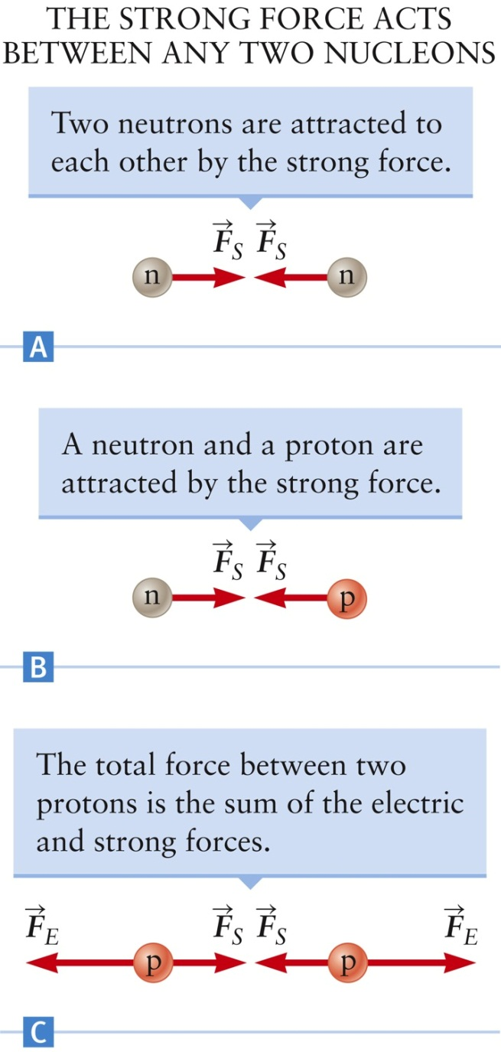
Strong Force
Pairs of protons, pairs of neutrons, and protons and neutrons all attract via the strong force
If only two protons are involved, the electric force is greater in magnitude than the strong force
  A nucleus containing just two protons is not stable
Section 30.1

Slide 19
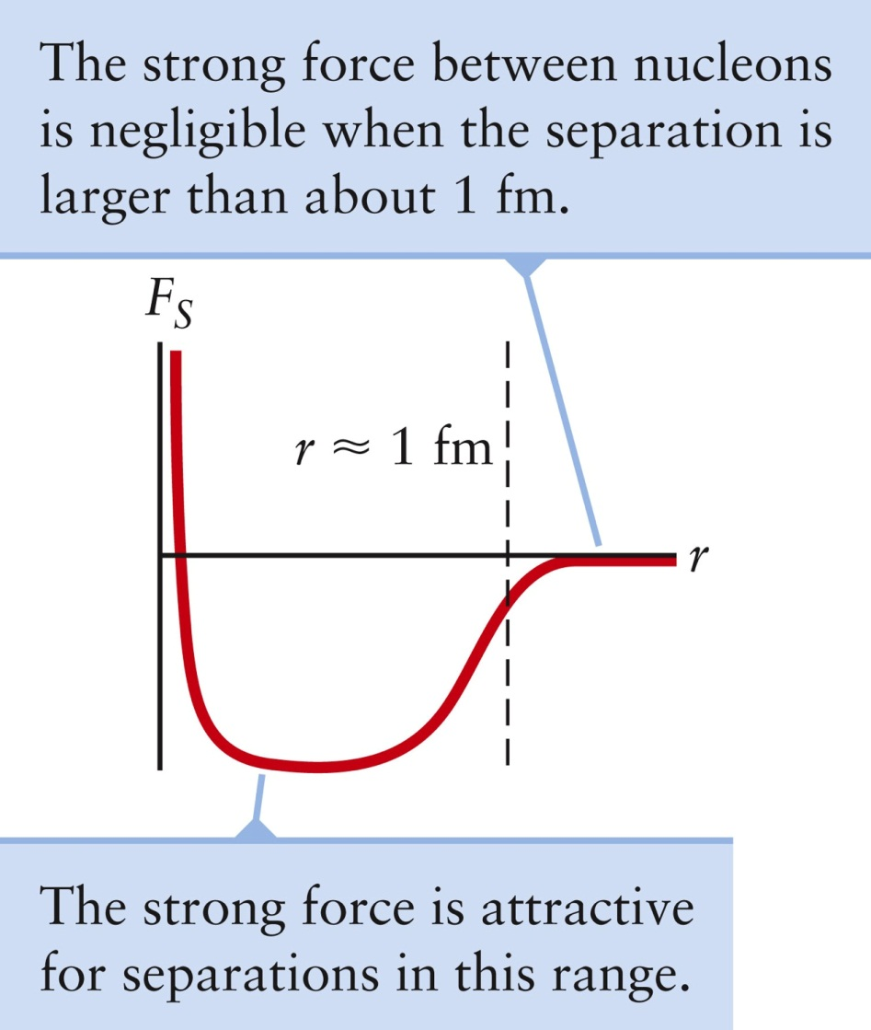
Strong Force and Distance
The strong force has an approximately constant magnitude when the nucleons are about 1 fm apart
The force is negligible when the distance is greater
The strong force does not play any role in binding electrons
Section 30.1

Slide 20
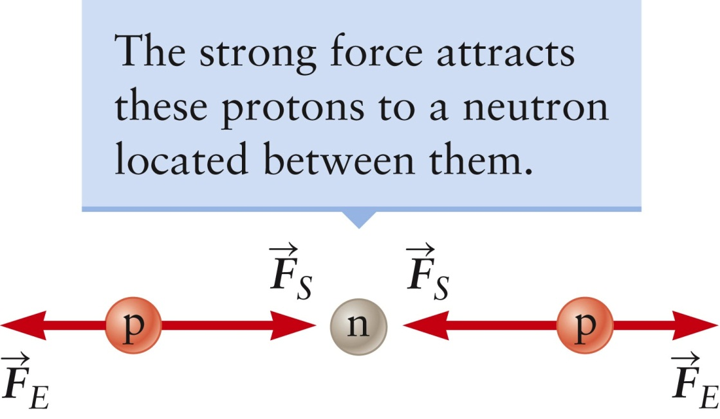
Stability in the Nucleus
Neutrons are essential for the stability of the nucleus
A neutron placed between two protons will add an attractive force that overcomes the Coulomb repulsion
  It will also increase the distance between the protons and decrease the Coulomb force
Section 30.1

Slide 21
Yukawa’s Theory- Mesonic Field
The particle responsible for nuclear binding forces
Are called Pi mesons.
are associated between protons and neutrons
are associated between protons and protons

Slide 22
Stability in the Nucleus, cont.
The number of neutrons generally increases as the atomic number increases
  As more and more protons are added to the nucleus, more and more neutrons are needed to keep the protons sufficiently separated so that the Coulomb force does not cause the nucleus to fly apart
Adding too many neutrons eventually results in an unstable nucleus
This is explained by the quantum theory of the nucleus called the nuclear shell model
  There are energy levels of nucleons inside a nucleus, similar to the energy levels of electrons within an atom
Section 30.1

Slide 23
Atomic mass unit
1 amu is taken as one twelfth of the mass of carbon atom
1 amu = 1.66038 x 10⁻²⁷ kg
Mass of proton = 1.007277 amu
Mass of neutron = 1.008665 amu

Slide 24
Mass and Energy Scales
Electric potential energy of protons in a nucleus is on the order of MeV
The potential energy associated with the strong force is negative and also on the order of MeV
The rest energy of the proton and neutron can be found from E = m c²
  E_{p} = 938 MeV
Mass can be expressed in units of energy/c²
  m_{p} = 938 MeV/c²
Mass can also be expressed in atomic mass units [u]
  1 u = 1.66 x 10⁻²⁷ kg = 931.5 MeV/c²
Section 30.1

Slide 25
Binding Energy

Slide 26
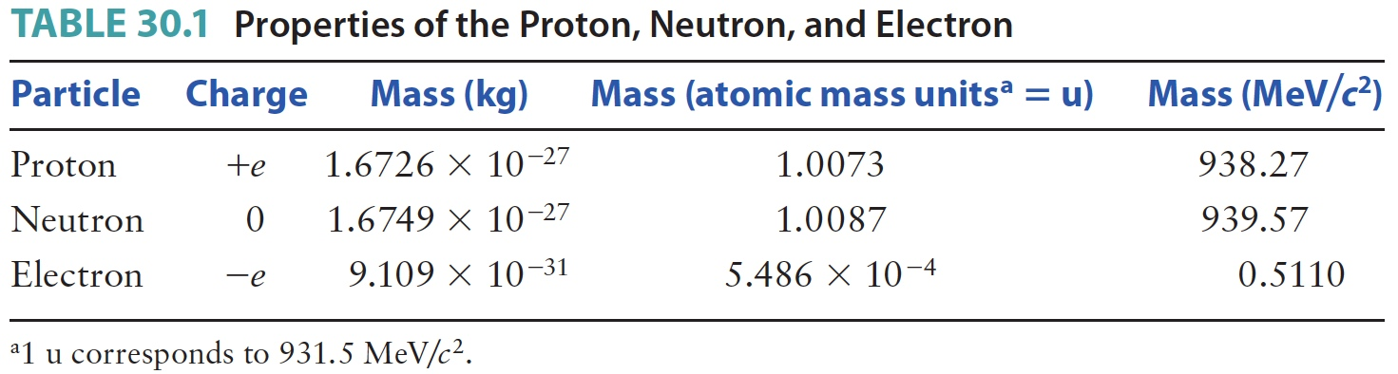
Properties of Particles
Section 30.1

Slide 27
Mass Defect and Packing Fraction
Mass Defect Δ = M - A
Mass defect gives the deviation of the atomic mass from the
whole number A.
p = packing fraction

Slide 28
Problem Based Learning 1
Calculate the binding energy and packing fraction for helium.
The atomic mass of Helium = 4.00387 u
Mass of proton = 1.007277 amu
Mass of neutron = 1.008665 amu
  1 u = 1.66 x 10⁻²⁷ kg = 931.5 MeV/c²

Slide 29
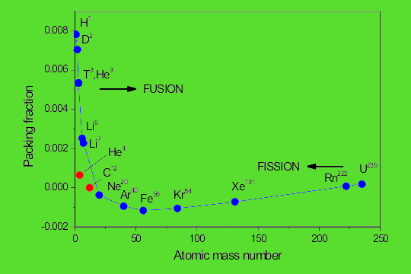
Negative Packing Fraction: Indicates that the nucleus is stable and has a strong binding energy.
Positive Packing Fraction: Suggests that the nucleus is less stable and may undergo changes, such as fission or decay.

Slide 30
Problem based learning 2
Two isotopes of Oxygen having nuclear masses 15.990523 u and 17.994768 amu. Calculate the binding energy per nucleon in the two cases in MeV. What do you expect the relative abundance of the two isotopes.

Slide 31
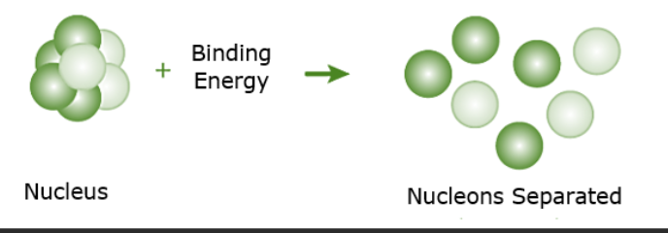
Notes:
Binding energy (B.E.) is the energy required to disassemble a nucleus into its constituent protons and neutrons. It is derived from the mass defect, which is the difference between the total mass of the individual nucleons and the actual mass of the nucleus. According to Einstein's mass-energy equivalence relation, the binding energy can be expressed as:

Slide 32
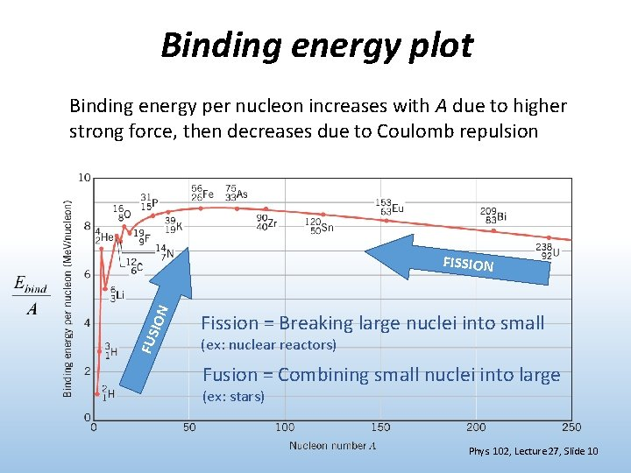

Slide 33
Calculation of energy released in the Nuclear Process

Slide 34
Radioactivity
Some nuclei are unstable and decay spontaneously into two or more particles
This process is called radioactive decay
  The term radioactivity refers to the process in which a nucleus spontaneously emits either particles or radiation
When a nucleus decays, it can emit particles or photons
The decay products were originally called alpha, beta and gamma
  Generally all are called “radiation” even though only gamma is actually a form of electromagnetic radiation
Section 30.2

Slide 35
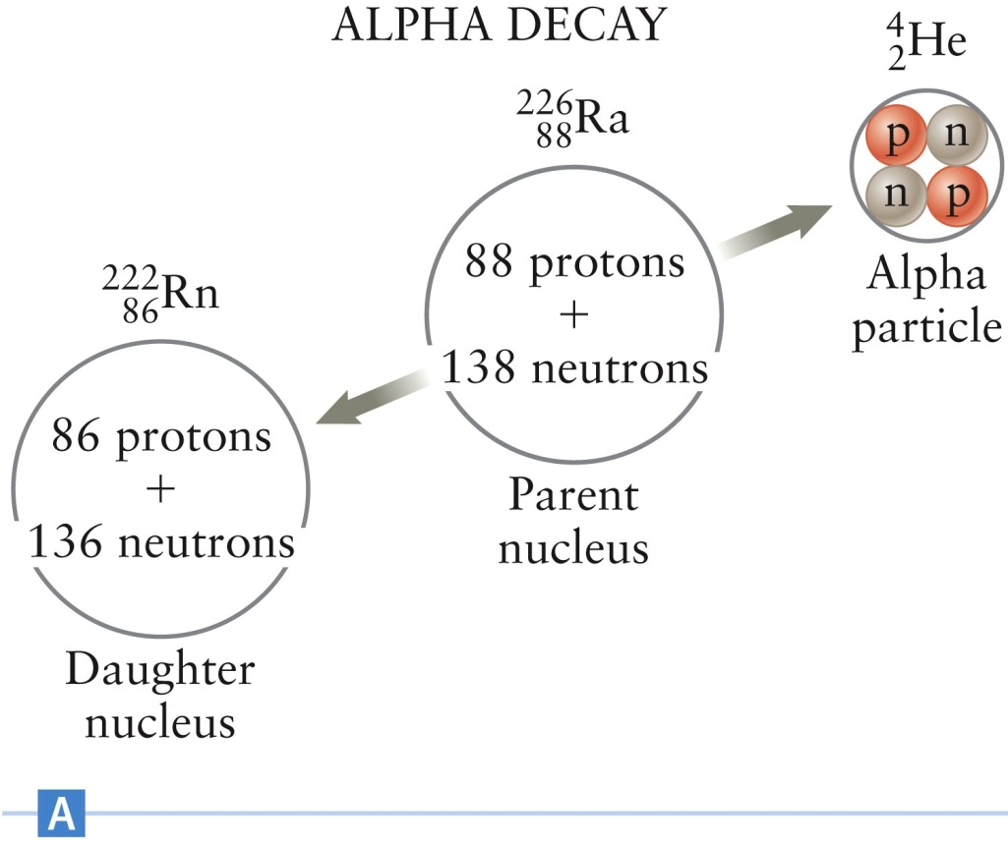
Alpha Particles

Slide 36
Alpha Particles, cont.
Decays follow patterns similar to chemical reactions
  Parent nucleus → daughter nucleus + alpha particle
    The daughter nucleus and the alpha particle are collectively known as decay products
Section 30.2

Slide 37
Beta Particles
There are two varieties of beta particles
  Negatively charged particle is an electron
  Positively charged particle is a positron
    The antiparticle of the electron
    Except for charge, identical to the electron
Electrons and positrons have the same mass
They are both point charges
Section 30.2

Slide 38
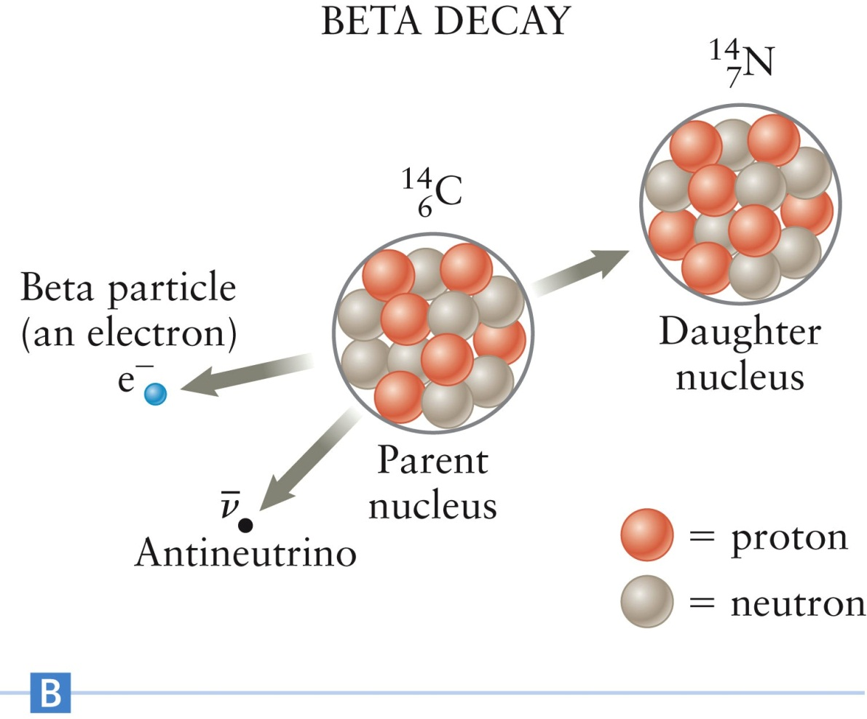
Beta Particles, cont.
  Parent nucleus → daughter nucleus + beta particle + antineutrino

Slide 39
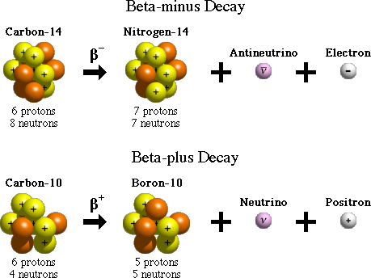
Beta Decays

Slide 40
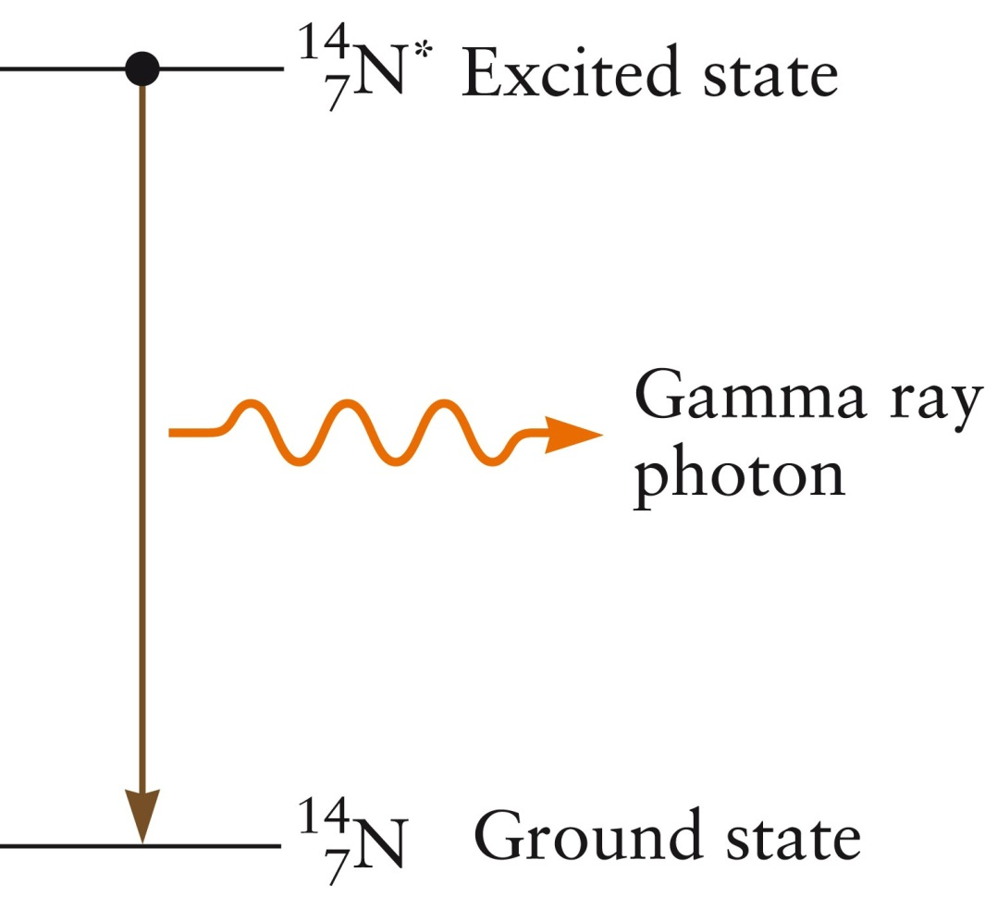
Gamma Decay
  Parent nucleus → daughter nucleus + gamma ray

Slide 41
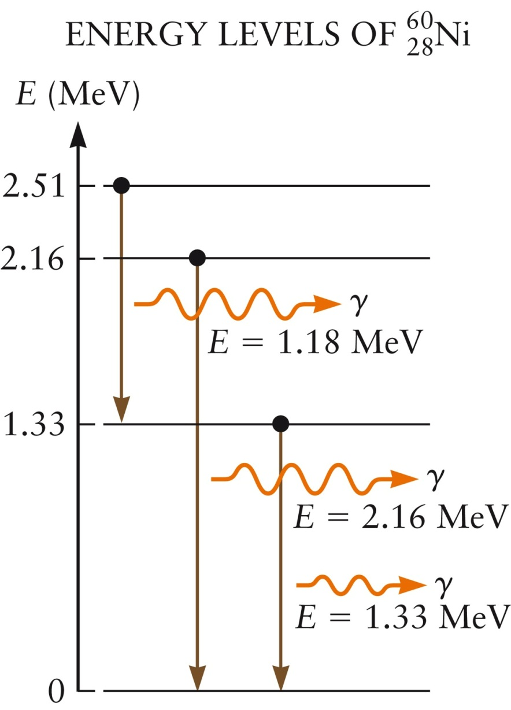
Gamma Rays and Energy Levels
The excited nucleus can emit gamma rays with many different energies
  Depends on which excited and final states are involved
Typical gamma rays have energies from about 10 keV to 100 MeV or higher
Section 30.2

Slide 42
Gamma Rays vs. X-rays
Gamma rays and X-rays are both portions of the electromagnetic spectrum
Their energy ranges overlap
By convention, the distinction is based on the origin of the radiation
  Gamma rays are produced in nuclear reactions
  X-rays are generated by processes involving atomic electrons
Section 30.2

Slide 43
Conservation Rules
Conservation of mass-energy
  The total energy at the start of the decay must equal the total energy at the end of the decay
  You must also account for the conversion of mass to energy and energy to mass
Conservation of momentum
Conservation of electric charge
  The total number of charged particles may change, but the total amount of charge will not
Conservation of nucleon number
Section 30.2

Slide 44
Radioactive Decay Series
When a nucleus undergoes a radioactive decay, it may be converted into another type nucleus
  If the process involves alpha or beta emissions
The decay reactions often continue through numerous steps
Eventually, a stable daughter nucleus is produced
Section 30.2

Slide 45
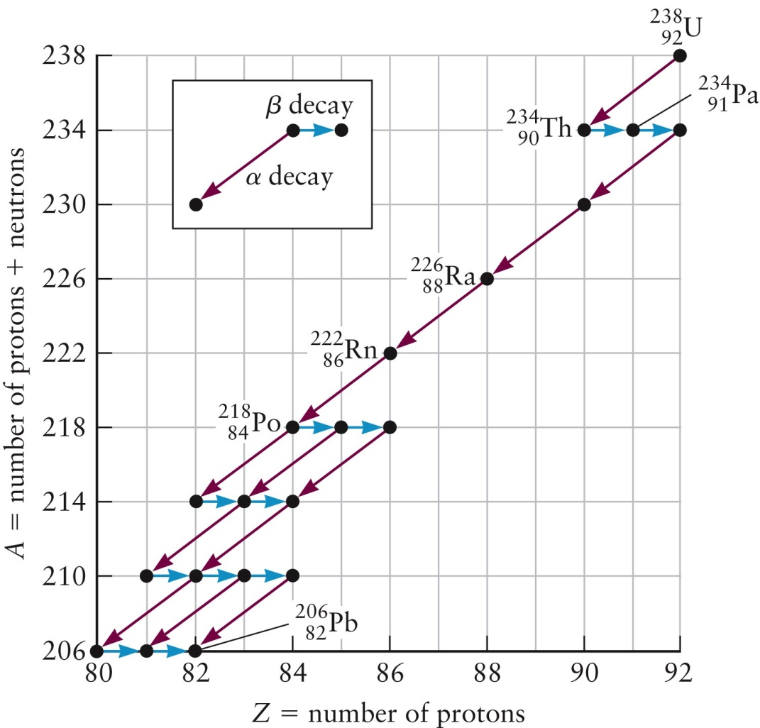
Decay Series, Example (Uranium Series)
Section 30.2

Slide 46
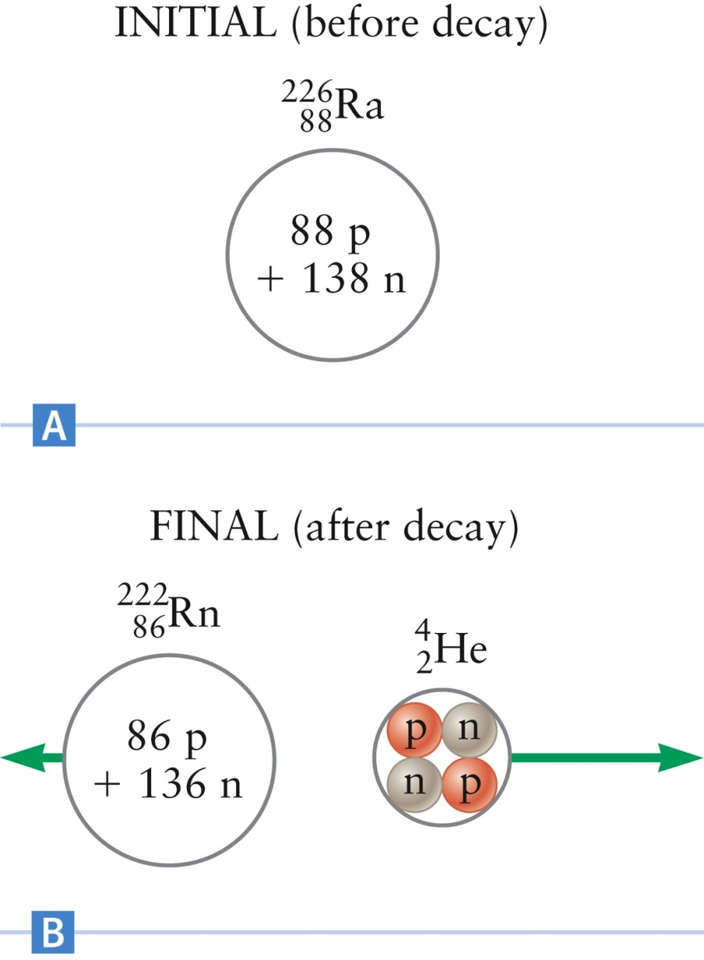
Energy in a Nuclear Reaction
Total mass before = 226.0234 u
Total mass after = 226.0202 u
E_{reaction} = 4.8 MeV
This energy is typically released as kinetic energy of the products
To conserve momentum, the products are emitted in opposite directions
Section 30.2

Slide 47
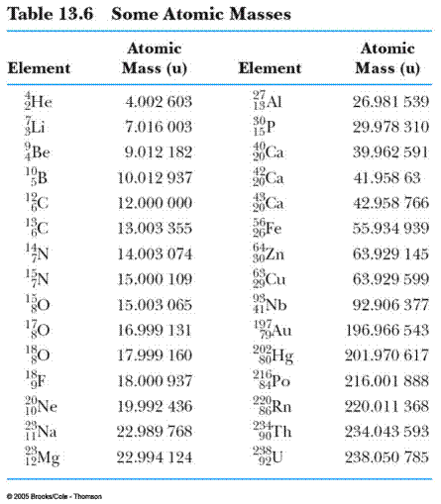

Slide 48
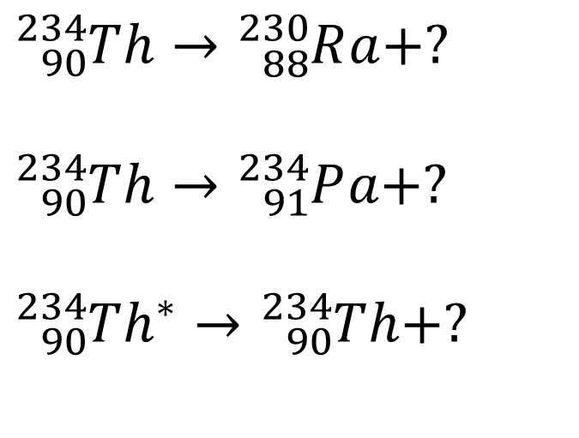
Problem based Learning
(a) A beta particle emitted during a nuclear decay has a kinetic energy of 50,000 eV. What is its speed?
m_{e} = 9.109 ×10⁻³¹ kg
(Compare relativistic calculation vs non-relativistic calculations)
(b) Complete the following reactions.
$${}_{90}^{234}Th→{}_{88}^{230}Ra+?$$
$${}_{90}^{234}Th→{}_{91}^{234}Pa+?$$
$${{}_{90}^{234}Th}^{∗}→{}_{90}^{234}Th+?$$

Slide 49
Half-life
Individual nuclei decay one at a time, at random times
  It is not possible to predict when a particular nucleus will decay
  This randomness is a feature of quantum theory
The probability for decay can be given
The probability is specified in terms of the half-life of the nucleus, T_{1/2}
Assume an initial number of nuclei, N₀, are present in a sample at t = 0
At time t = T_{1/2}, half of the nuclei will have decayed
Section 30.2

Slide 50
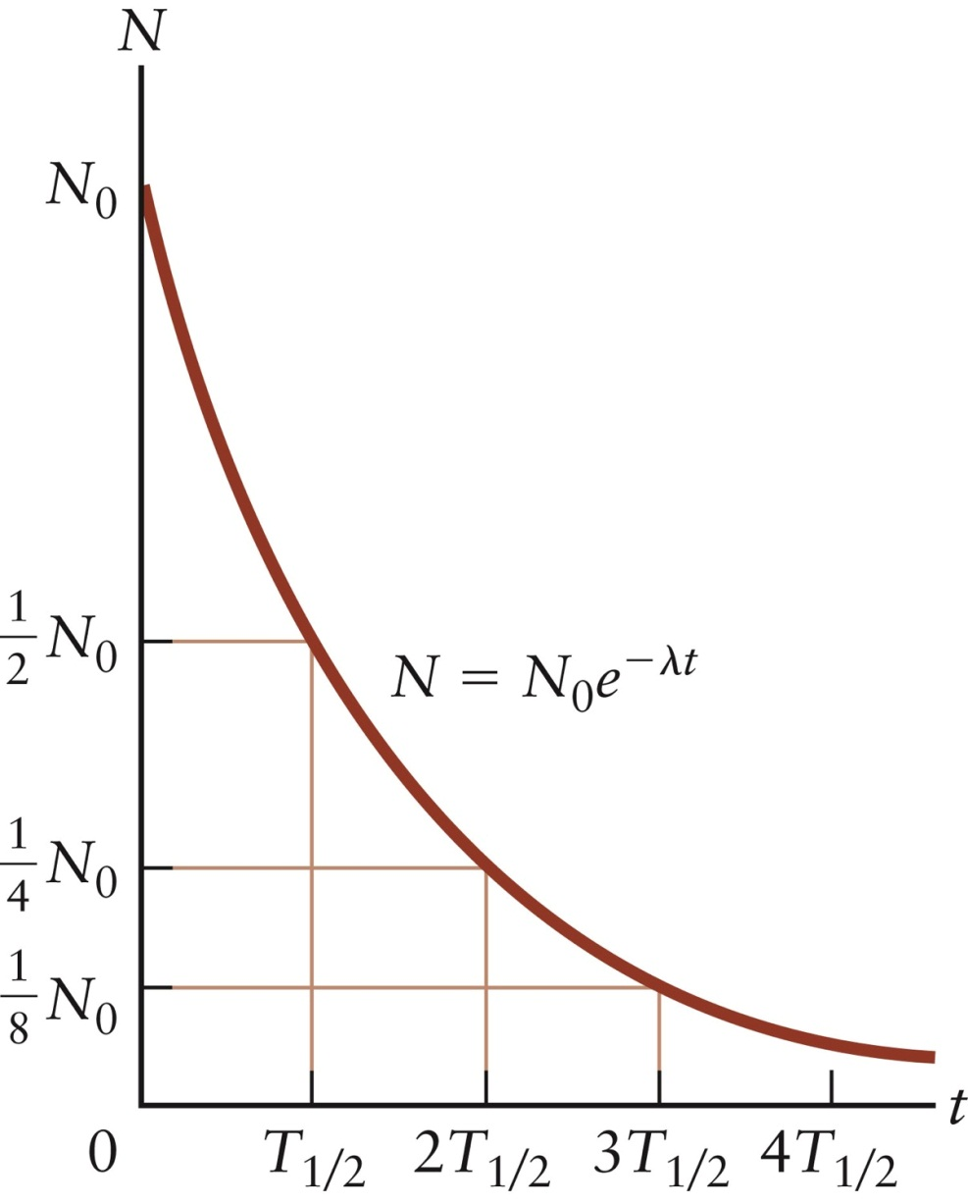
Half-life
The decay constant, λ, is defined so that

Slide 51
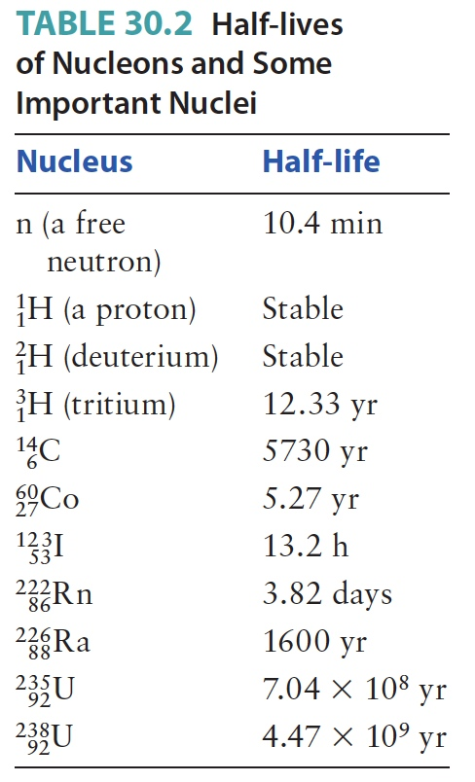
Half-life, final
In terms of the decay constant, the half-life is
Section 30.2

Slide 52
Problem Based Learning:
1. The isotope ²⁰₉F is used in a medical procedure called positron emission tomography (PET). The half life of ²⁰₉F is approximately 110 minutes. If your doctor has a sample with 16 g pure ²⁰₉F at t=0, how much ²⁰₉F will he have 330 minutes later?
2. A certain radioactive substance has a disintegration constant λ = 1.44×10 ⁻³ per hour. In what time will 75% of the initial number of atoms disintegrate?

Slide 53
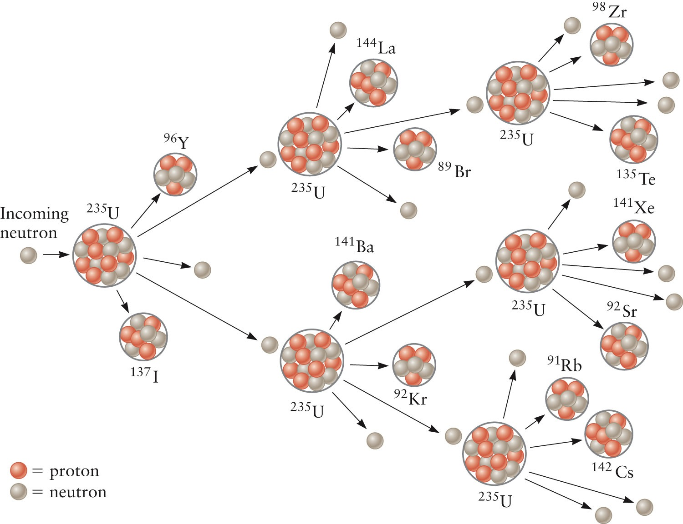
Chain Reaction, Example

Slide 54
In class Group PBL-01:
Write down all the reaction equations you can see under the chain
reaction processes in the below fission process.

Slide 55
Tutorial 2- Nuclear Physics
19-01-2026
Good Luck!

