Slide 1
PHY1091
PHY2081
Atomic Physics
Atomic & Nuclear Physics

Slide 2
(Man as Matter) vs (Man as Wonder)
“Is man what he seems to the astronomer, a tiny lump of impure carbon and water impotently crawling on a small and unimportant planet? Or is he what he appears to Hamlet? Is he perhaps both at once? ”
-Bertrand Russell in A History of Western Philosophy
humanity is reduced to its physical components: carbon, water, and a fleeting presence on a minor planet in a vast, indifferent universe.-
the astronomer's lens
“What a piece of work is man! How noble in reason, how infinite in faculty”-Shakespearean lens

Slide 3
The Paradox:
Russell’s final question—“Is he perhaps both at once?”—is the philosophical crux. It suggests:
Duality of existence:
We are both matter and meaning, biology and biography.
Tension between perspectives:
The scientific and poetic truths coexist, even if they seem incompatible.
Human complexity:
Our ability to reflect on our own insignificance is itself a profound trait.
This duality is central to modern thought: we are atoms with awareness, stardust that dreams.

Slide 4

Both views are valid, but not simultaneous

Slide 5
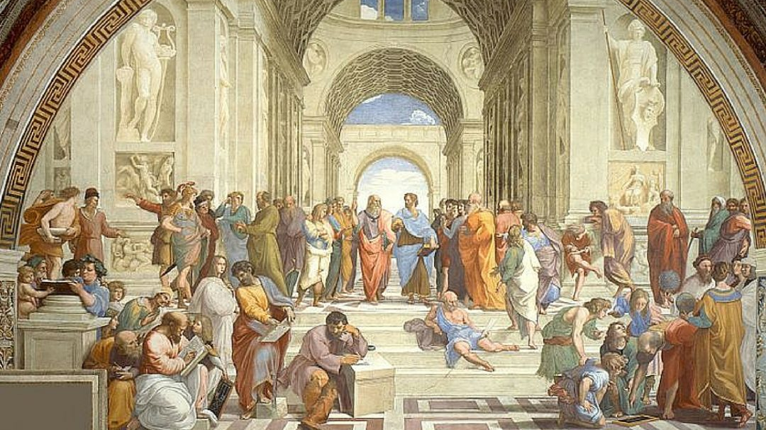

Slide 6


Slide 7
Lecture’s details and Class details
Lecturer: Prof. Lilani Attygalle
BSc (Physics Special, University of Colombo-2002,
PhD in Theoretical Physics-2008 (University of Toledo, USA)
Time: Biweekly from Oct 21, 2025 till Jan 13, 2026
Mode: Hybrid mode
(Physical Lectures and LMS activities)
Tutorial classes: 8:55am-9:45 am-Thursdays
Core course-General Physics
Office hours: Open door policy, or by appointment

Slide 8
Learning Outcomes
On successful completion of the course students will be able to:
1. Have acquired knowledge and understanding about the electronic and nuclear structure of atoms.
2. Have solved problems related to the structure of atoms and the effect of ionizing radiation on the body and the environment.
3. Have an appreciation of the influence of atomic and nuclear physics on modern scientific development.
4. Have the foundations for examining in more detail various aspects of experimental and theoretical physics which relate to both atomic and nuclear physics.
5. Be able to explain the key areas in which Atomic and Nuclear Physics affects everyday living.

Slide 9
Week | Date | Topic | Activity / Assessment
1 | Oct 21 (1 hr) | Introduction to Atomic & Nuclear Physics | Overview lecture –(Pre-Test-LMS)
2 & 3 | Oct 28 (2 hrs) | Structure of the Atom + Atomic Spectra | Lecture + discussion
 |  | Bohr’s Model of the Atom + Wave Mechanics | FA 1 (Quiz1-LMS or concept check)
4 & 5 | Nov 11 (2 hrs) | Hydrogen Atom + Quantum Numbers | Lecture + problem solving
 |  | Multi-electron Atoms + Spin-Orbit Coupling | FA 2 (Quiz2)
6 & 7 | Nov 25 (2 hrs) | Chemical Properties + Periodic Table | Lecture + group activity
 |  | Quantum Mechanical Approach + Energy Configurations | FA 3 (Concept mapping/ Quiz3)
8 & 9 | Dec 9 (2 hrs) | Atomic Excitation + Principles of Lasers | Lecture + real-world applications
 |  | Applications of Atomic Physics (Spectroscopy, Astrophysics) | FA 4 (Quiz4)
— | Dec 23 (2 hrs) | No class (Holiday week) | —
10& 11 | Dec 30 (2 hrs) | PHY2081 Focus: Structure of the Nucleus + Nuclear Reactions | Lecture + discussion
 |  | PHY2081 Focus: Fission + Fusion + Stability of Nucleus | FA 5 (Quiz5)
12 & 13 | Jan 13 (2 hrs) | Experimental Techniques in Atomic & Nuclear Physics | Lecture + discussion
 |  | Review + Timeline Creation | FA 6 (Quiz6)
14 (1h) | Jan 27 (LMS) | Post test (PHY 2081 and PHY1090-online)

Slide 10
LMS
Course: PHY 1091 Atomic Physics
Course: PHY 208 1.0 Atomic Physics & Nuclear Physics-2025-Sem

Slide 11
How do I calculate the Final Grade?
80% attendance is compulsory
Pre-Test-50 points
Post Test- 50 points
Bonus Credits- 10% from the post-test score if Post-test mark is greater than Pre-Test -must attempt both Pre-test and Post test
6-online Assessments-(best 5-300 points)
Final Exam (MCQs, Fill in the blanks + one essay - 600 points
Total points = 1000 points
This course does not accommodate makeup assessments of any kind.

Slide 12
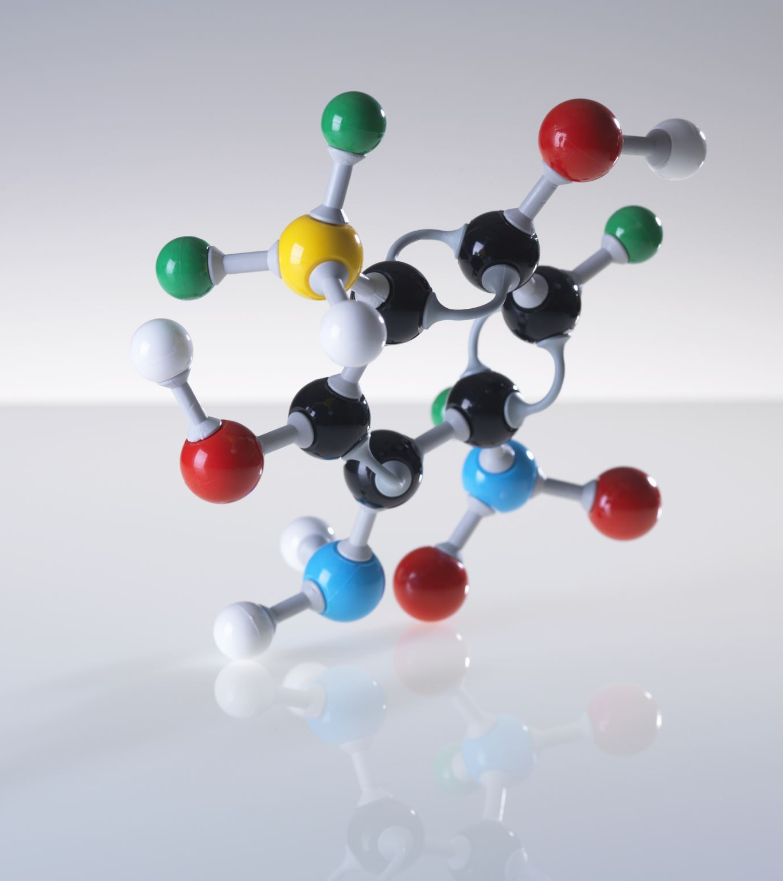
Why Atomic Physics Is Core to the Curriculum?
1. Foundation of Quantum Mechanics
2. Understanding Matter and Energy
3. Technological Applications
4. Bridge to Nuclear and Particle Physics
5. Experimental and Analytical Skills
6. Curricular Integration
Why It Matters for Students?
Builds conceptual clarity for advanced topics.
Enhances problem-solving and modeling skills.
Prepares students for research, teaching, and industry roles in physics and beyond.

Slide 13
Opportunities for you
Summer Internships at CERN, Geneva, Switzerland
(Apply at the fourth year of your Physics Special Degree)
Phd scholarships at CERN, Geneva, Switzerland
PhD scholarship at United States, Europe, Australia, Asia
(After completing standardized tests, (GRE, IELTS or TOEFL)+ Four-year Degree
Industry (Need a PhD, or MSc)
Industry opportunities at Apple, Intel, IBM, Fist-Solar, Google…
Academia (PhD or Mphil)
Joining Local or international research lab,
Joining as a Senior Lecturer, Assistant Professor

Slide 14
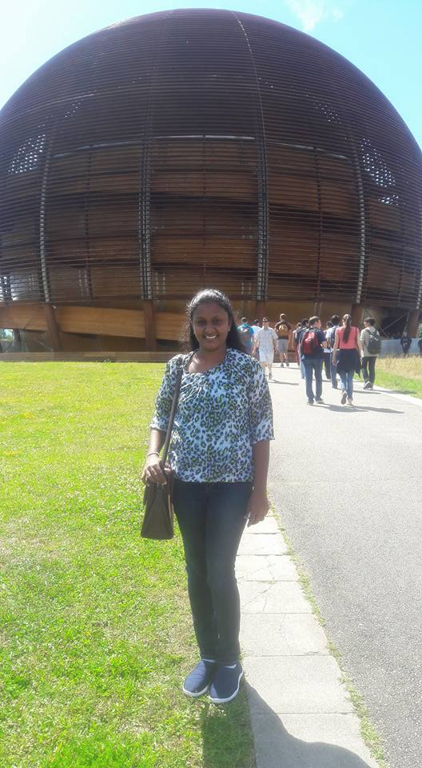

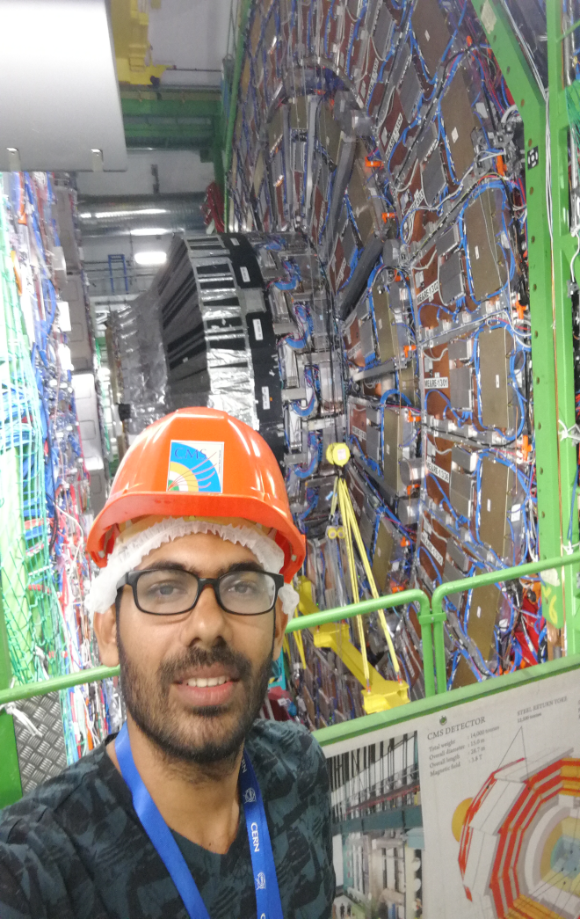
Summer Intern scholars from USJ at CERN during 2017-2023
2017 Summer Student
2018 Summer Student
2019 Summer Student

Slide 15
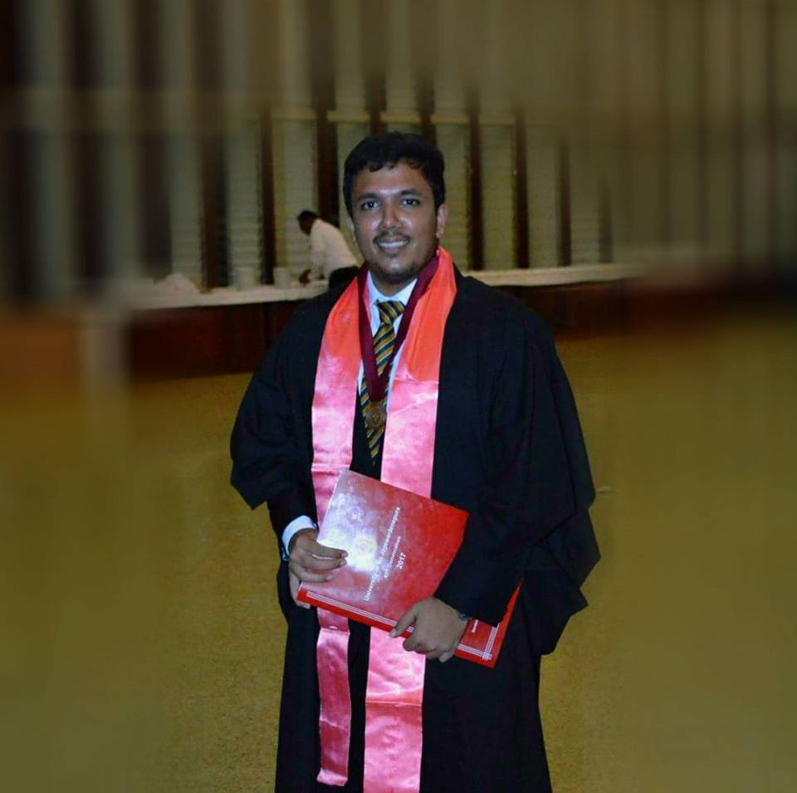
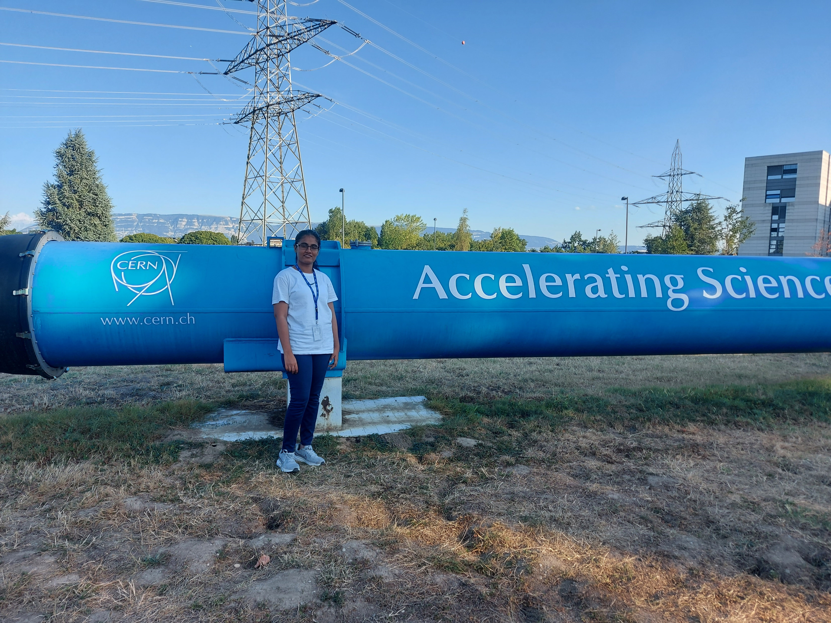
2018-PhD Scholar from USJP
2022 Summer Student
2018-PhD student-Nimantha Perera

Slide 16
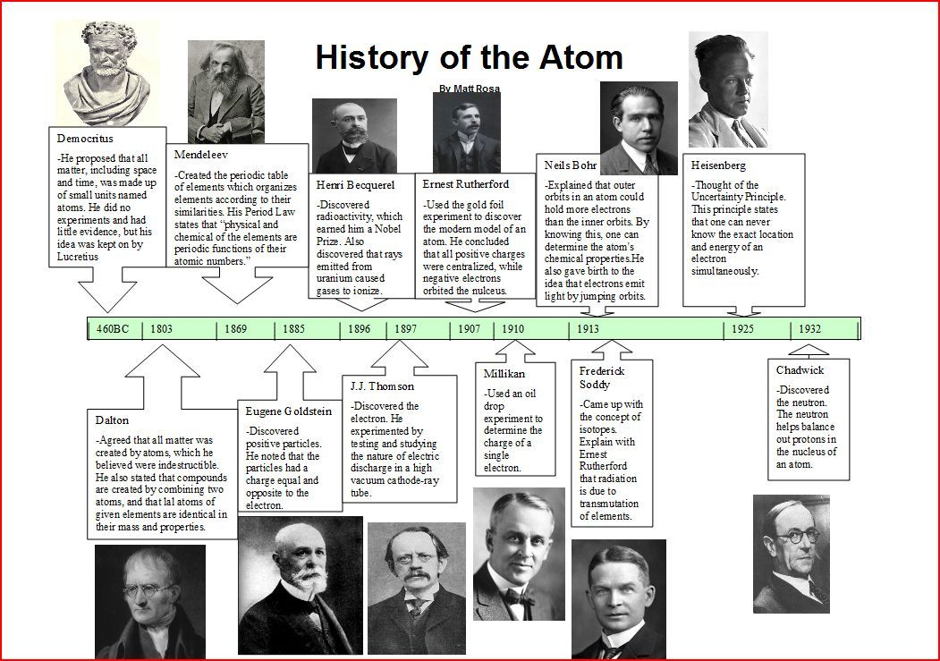

Slide 17
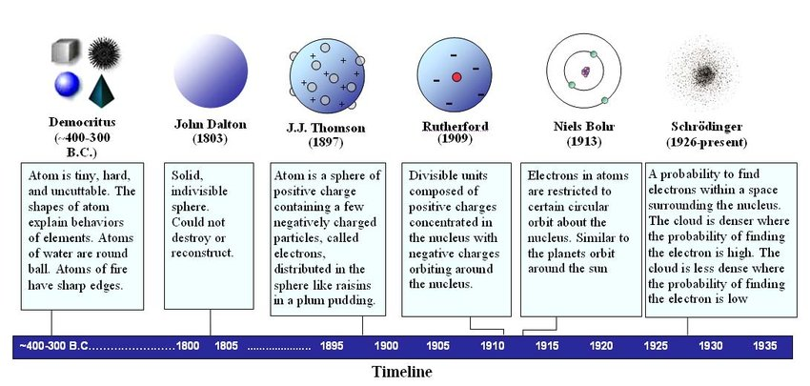
Atomic Models-Developments

